Slide 1
Tim Eggena | Sept 5, 2019
Presentation to the Georgia Task Force on Healthcare Access and Cost
Technology and
Remote Patient
Monitoring

Slide 2
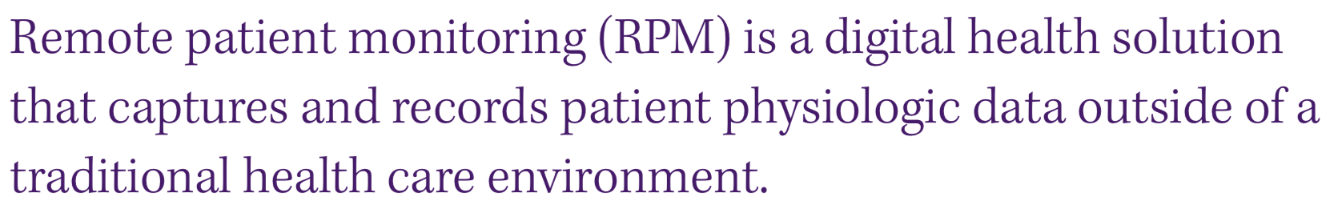

What is Remote Patient Monitoring?
30m Diabetic

Slide 3
Why Remote Patient Monitoring?
Provides visibility into the patient’s lives outside scheduled appointments
Allows for the chronic condition management to be timely, realistic, convenient, and meaningful to the patient’s lifestyle
Facilitates conversations between patients and physicians
Provides opportunities to intervene more quickly to prevent costly events and complications from occurring

Slide 4
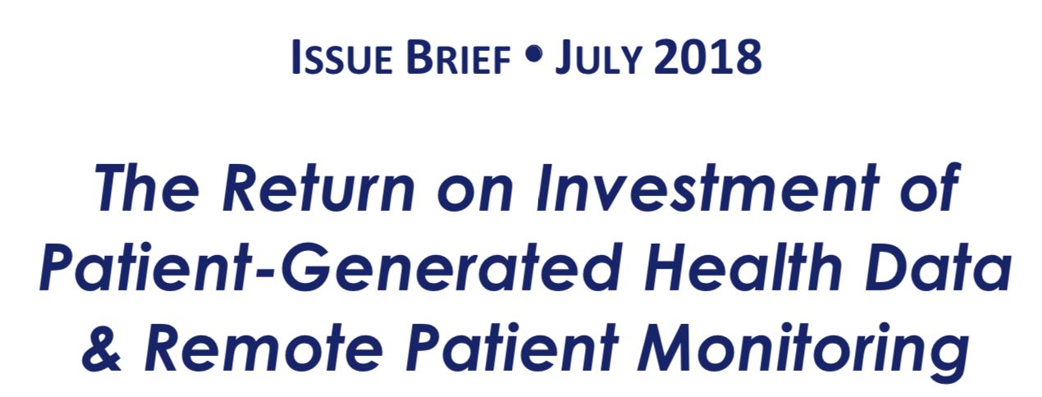
Why Remote Patient Monitoring?
Improves outcomes and lowers costs
Improves operational efficiency by reducing manual or redundant tasks for healthcare providers
Builds trusting and loyal relationships based on accurate data between healthcare providers and their patients
Engages patients in the planning, goal-setting, and self-management of their care, which ultimately improves care
Improves quality metrics and patient satisfaction scores
Reduces costs associated with readmission penalties, emergency department visits, and operations
www.ehidc.org

Slide 5
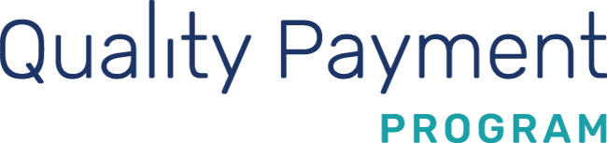
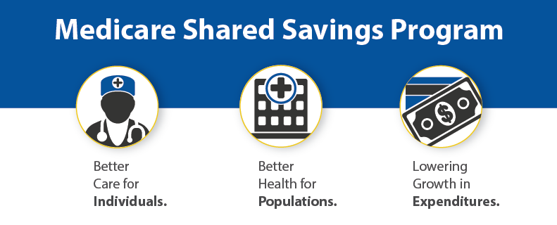
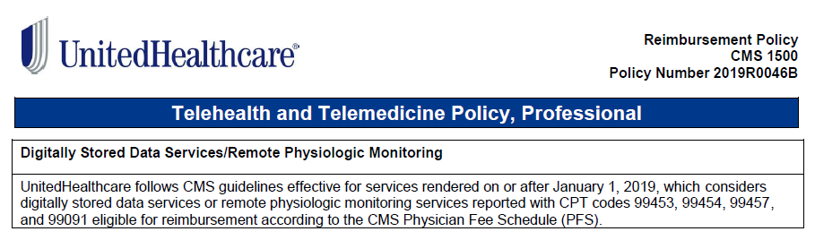
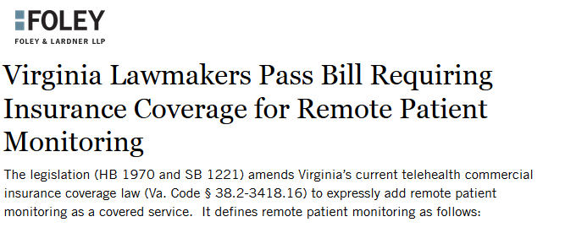
Expanding
Financial Incentives
CPT 99091 – Remote Patient Monitoring Interpretation
$58.38 – Once every 30 days (Current Medicare National Rates Shown)
“Collection and interpretation of physiologic data (e.g. glucose monitoring) digitally stored and/or transmitted by the patient and/or caregiver to the physician or other qualified health care professional; 30 minutes of time”
CPT 99453 – Remote Patient Monitoring Setup & Education
$19.46 – Once only
“Remote monitoring of physiologic parameter(s), initial; set-up and patient education on use of equipment”
CPT 99457 – Remote Patient Monitoring Treatment Management
$51.54 – Once every 30 days
“Remote physiologic monitoring treatment management services, 20 minutes or more of clinical staff, physician, other qualified healthcare professional time in a calendar month requiring interactive communication with the patient/caregiver during the month”
CPT 99454 – Remote Patient Monitoring Supplies
$64.15 – Once every 30 days
“Remote monitoring of physiologic parameter(s), initial; device(s) supply with daily recording(s) or programmed alert(s) transmission, each 30 days”
CPT 994X0 – Remote Patient Monitoring Treatment Management
TBD (New in 2020) – Once every 30 days
For an additional 20 minutes of remote patient monitoring and management time
Quality Measures
ACO27: Diabetes: Hemoglobin A1c Poor Control (>9%)
ACO36: All-Cause Unplanned Admissions for Patients with Diabetes
2018
2019
2020

Slide 6
The Diabetes Epidemic (US)
The Diabetes
84m Pre-Diabetic
30m Diabetic
30m Diabetic

Slide 7
The Diabetes Epidemic (US)
The Diabetes
84m Pre-Diabetic
30m Diabetic
30m Diabetic
Lower Risk
Fewer Complications
$
Higher Risk
More Complications
$$$$$

Slide 8


The Diabetes Epidemic (US)
The Diabetes
84m Pre-Diabetic
30m Diabetic
30m Diabetic
Lower Risk
Fewer Complications
$
Higher Risk
More Complications
$$$$$
Education, Coaching,
Diet, Exercise,
Patient Self-Management

Slide 9

The Diabetes Epidemic (US)
The Diabetes
84m Pre-Diabetic
30m Diabetic
30m Diabetic
Lower Risk
Fewer Complications
$
Higher Risk
More Complications
$$$$$
Education, Coaching,
Diet, Exercise,
Patient Self-Management
Monitoring & Medications
Physician Management

Slide 10
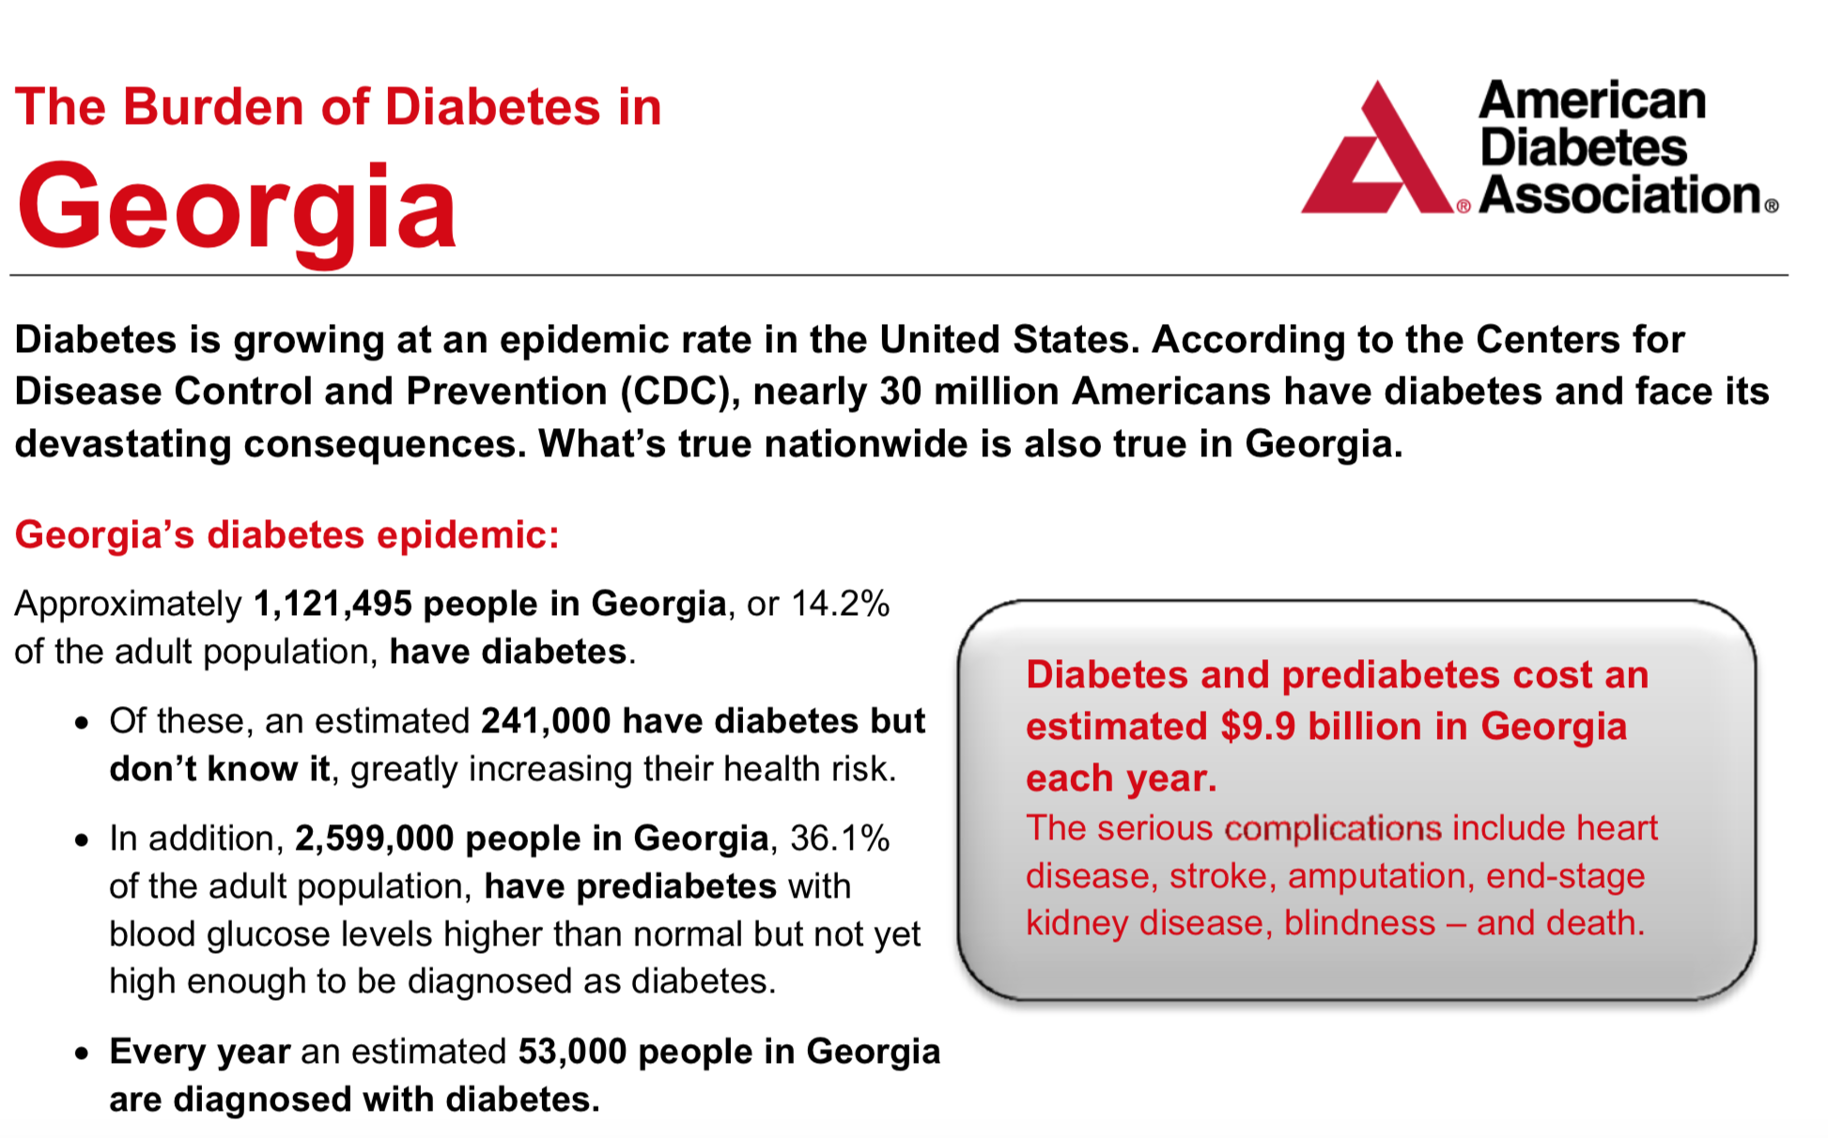

Slide 11
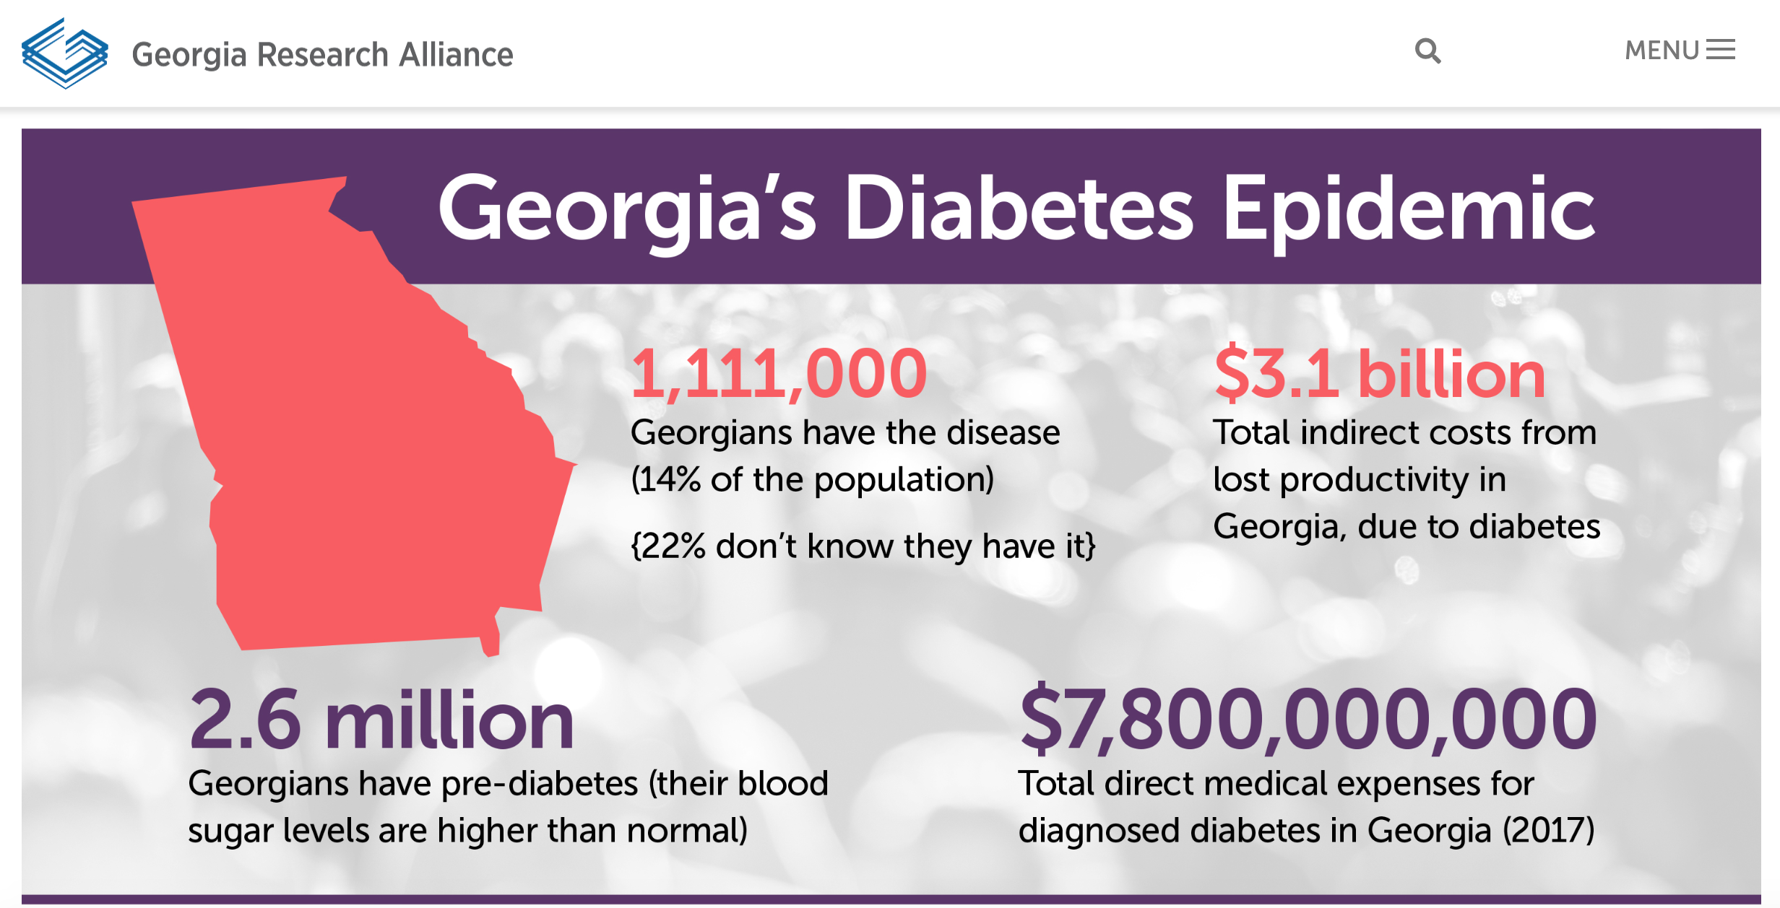

Slide 12
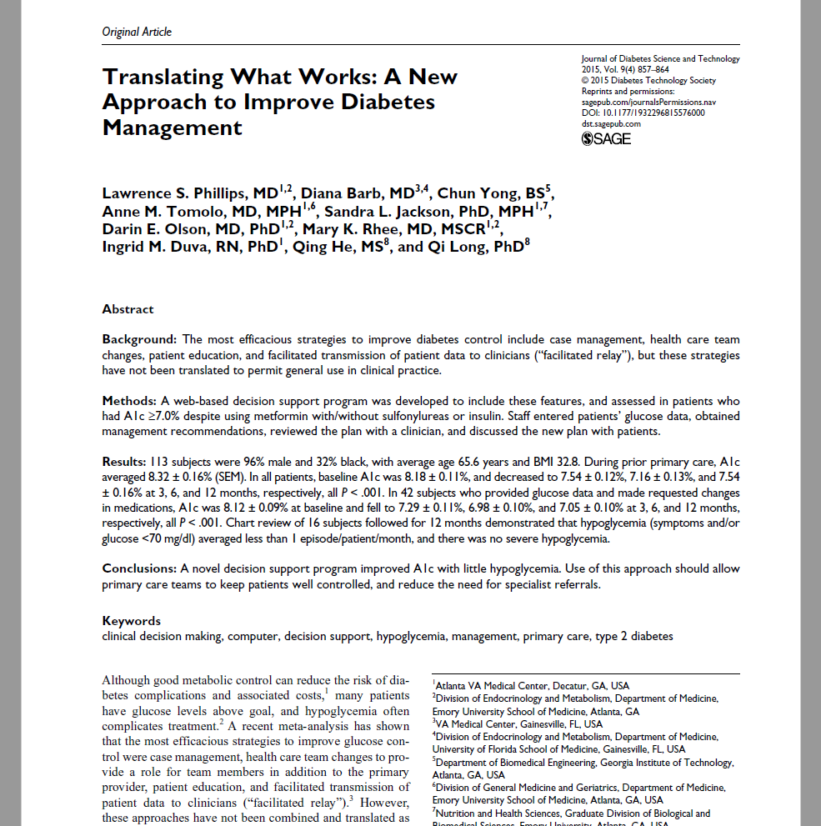




About Diasyst
Team out of diabetes clinical research group at Georgia Tech, Emory University, Atlanta VAMC
Research focus on clinical inertia, changing the natural history, and translating what works
Formed Diasyst Inc in 2015 to bring to market first comprehensive remote patient monitoring & pharmacotherapy management platform for diabetes
Actively partnering with telehealth, chronic care management, and other organizations targeting diabetes/related populations to add new lines of services for their clients

Slide 13


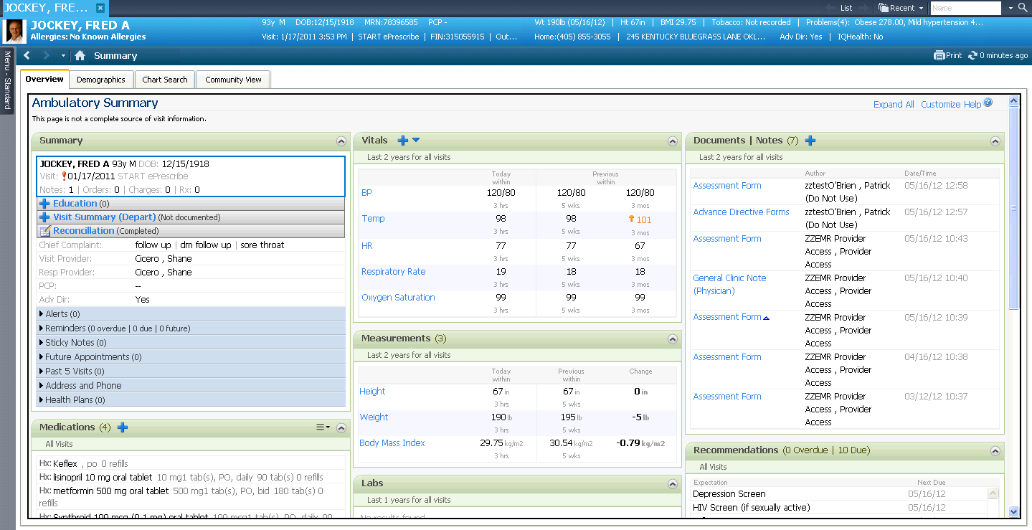
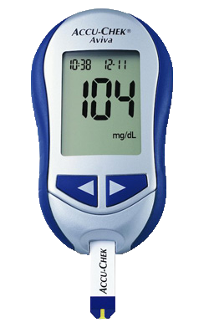
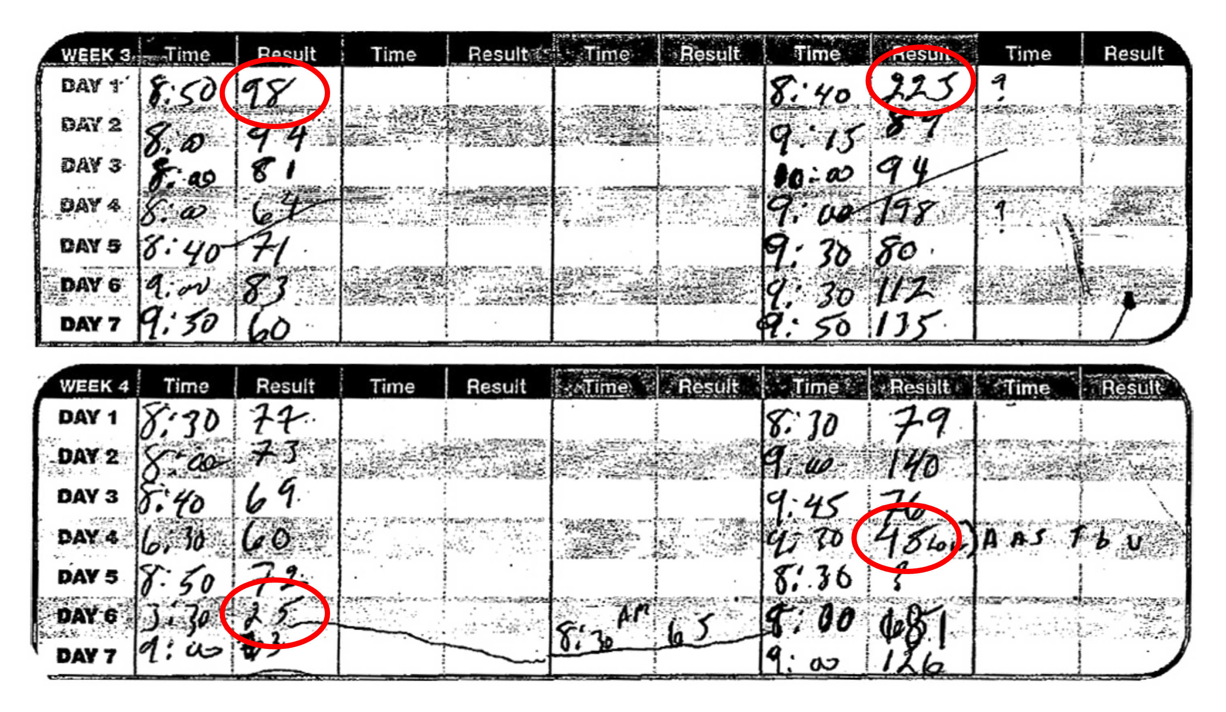
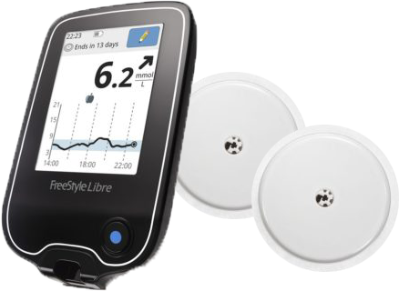

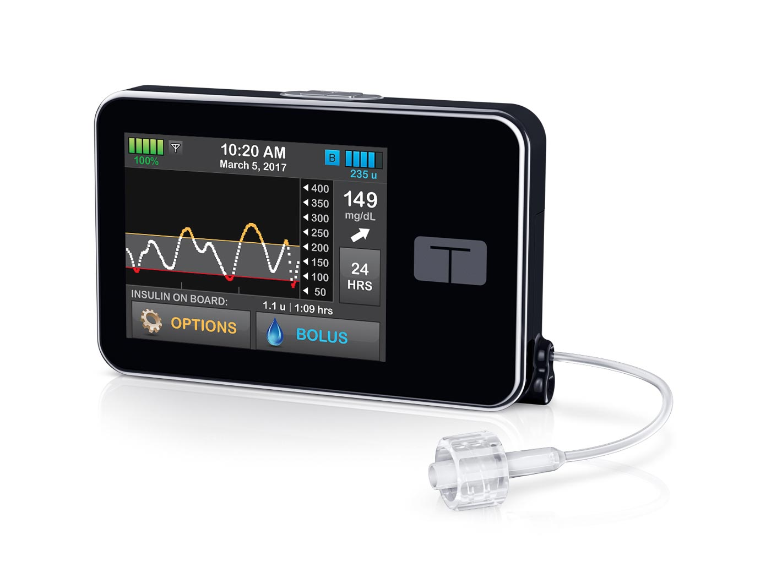

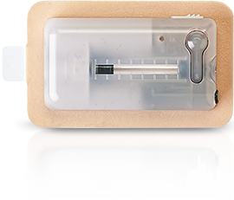
We’re Managing This
Disease
Extremely Poorly
Infrequent, Short
Physician Appointments
No Engagement for 3-12 Months, When Most Complications & Costs Occur
Complicated, Labor-Intensive Data Review
Too Many Meds to Prescribe & Adjust

Slide 14

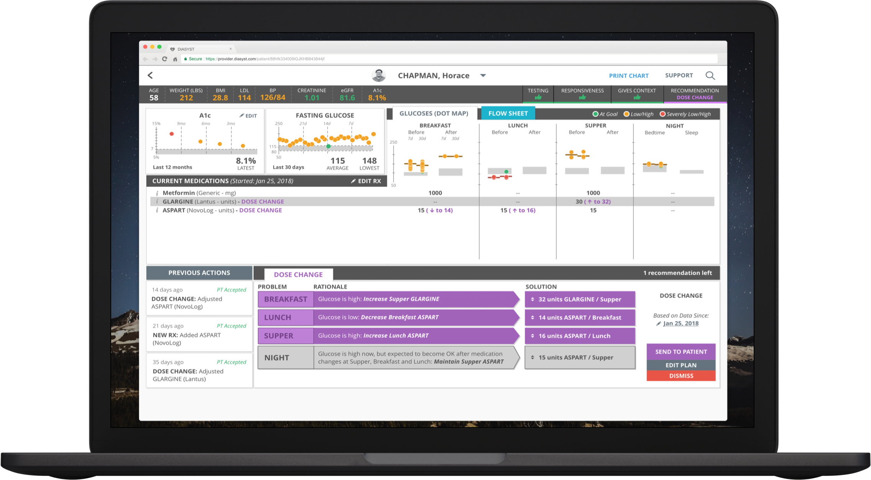
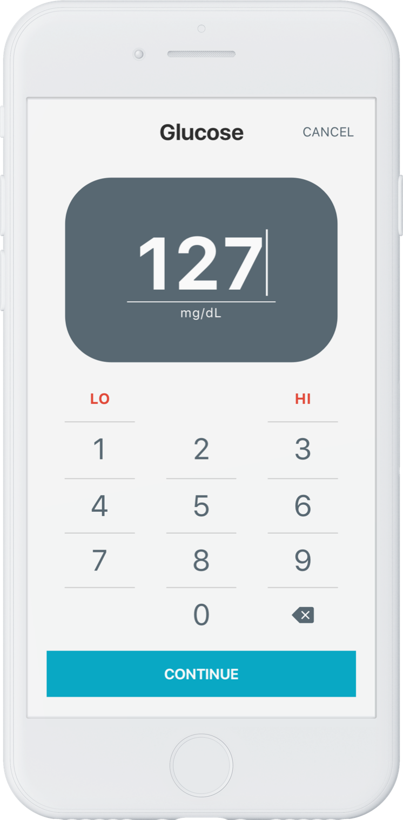
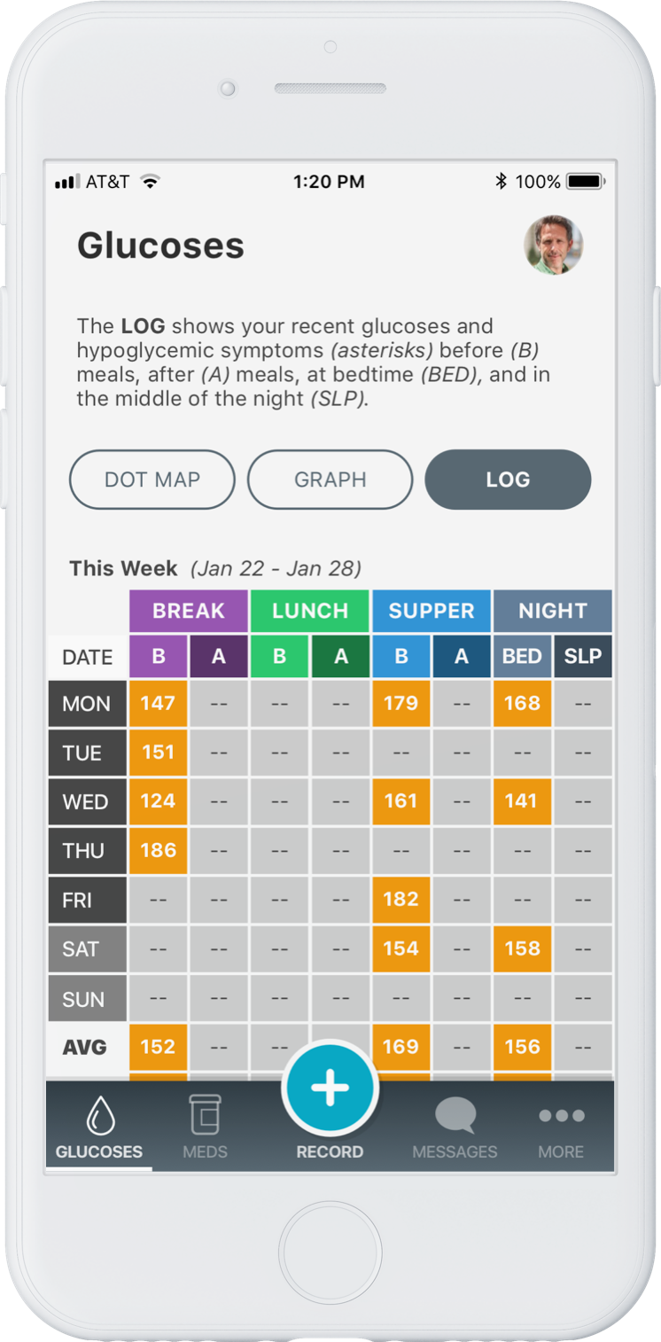
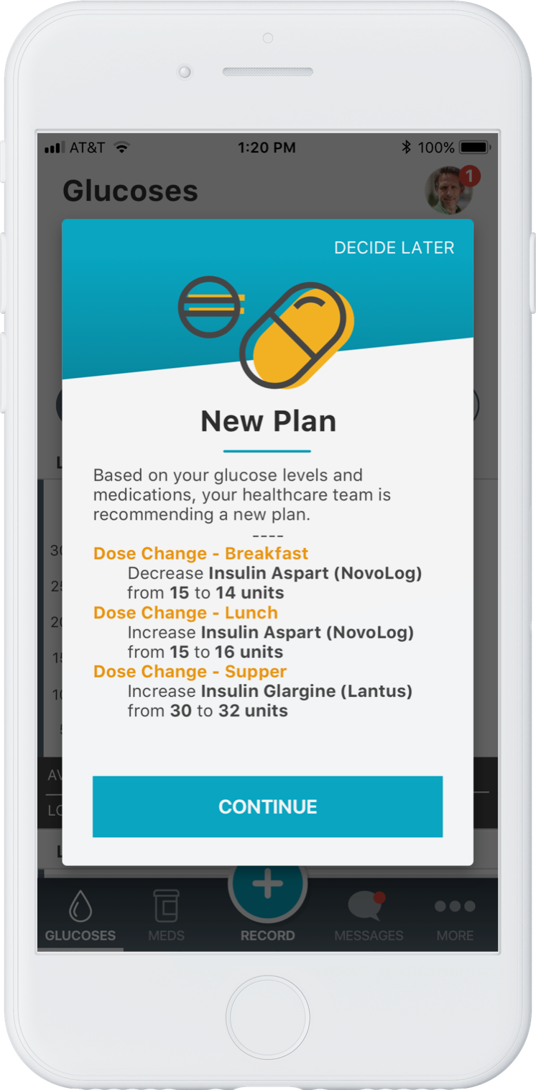
Our Approach
To Managing This Disease
Meaningful
Physician Appointments
Regular Provider Engagement Outside of Clinic, Preventing Complications & Lowering Costs
Structured Data Collection, Analysis, Review
Proper Medication Usage & Adjustment

Slide 15
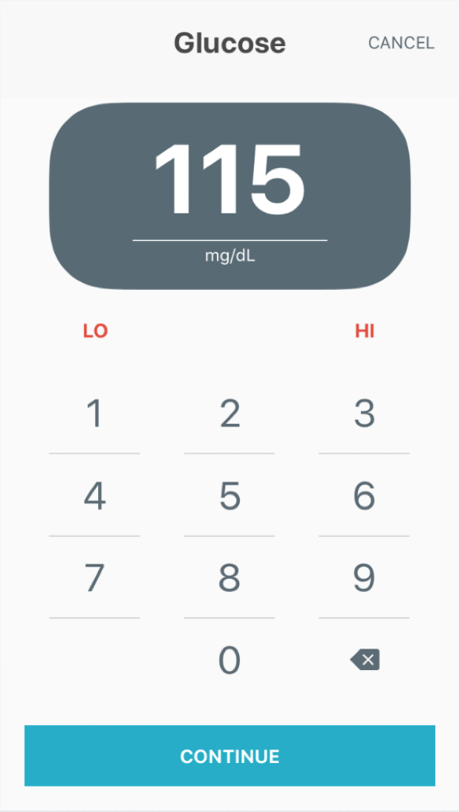
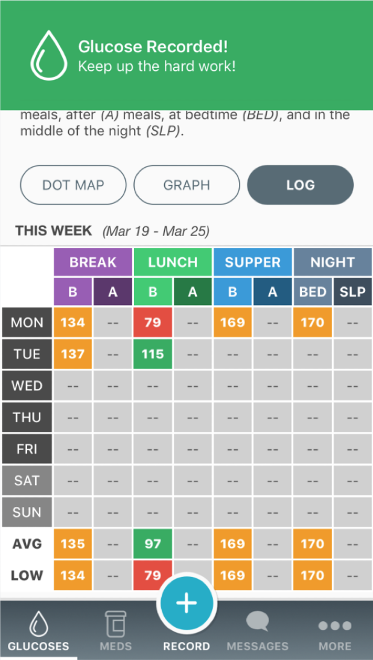
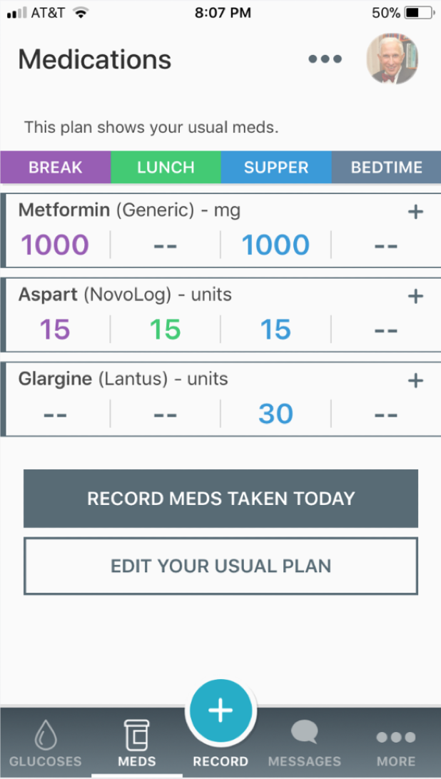
iOS and Android apps allow patients to log their readings, understand their patterns, view their medication plans and instructions, and receive messages, reminders, and other important info from their healthcare provider.
Patient’s Engagement Tool

Slide 16
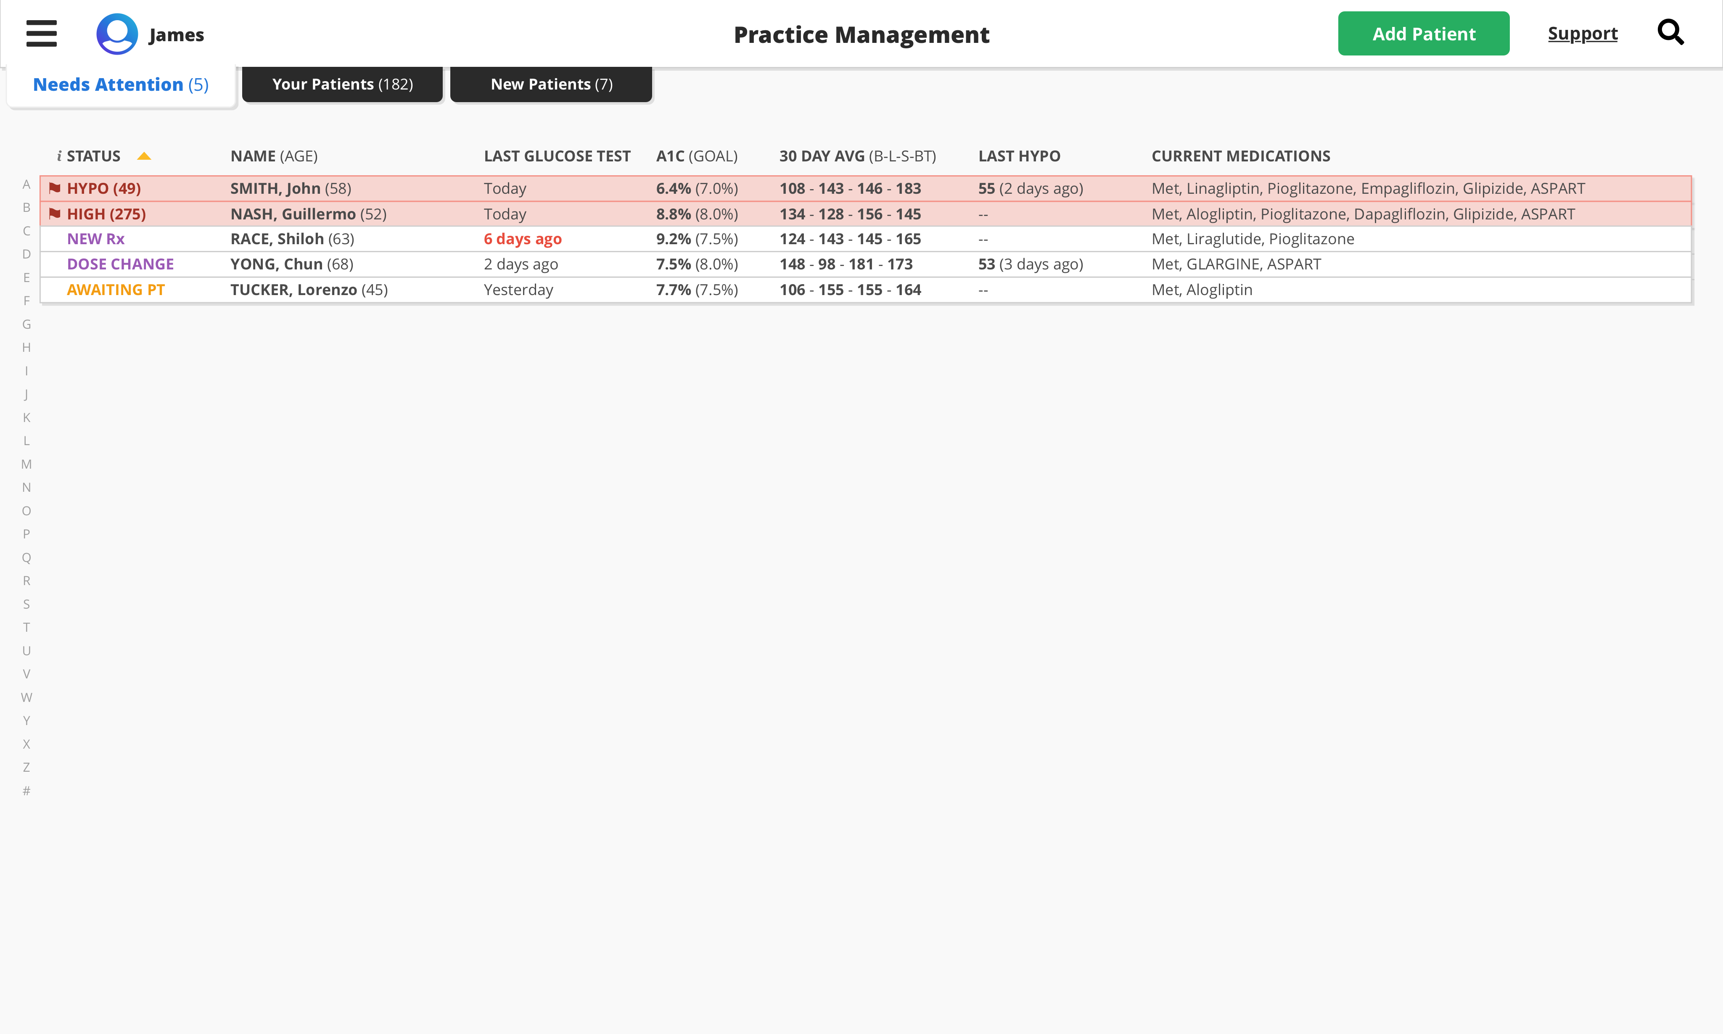
Physician’s Management Tool

Slide 17
Physician’s Management Tool

Slide 18
Physician’s Management Tool

Slide 19
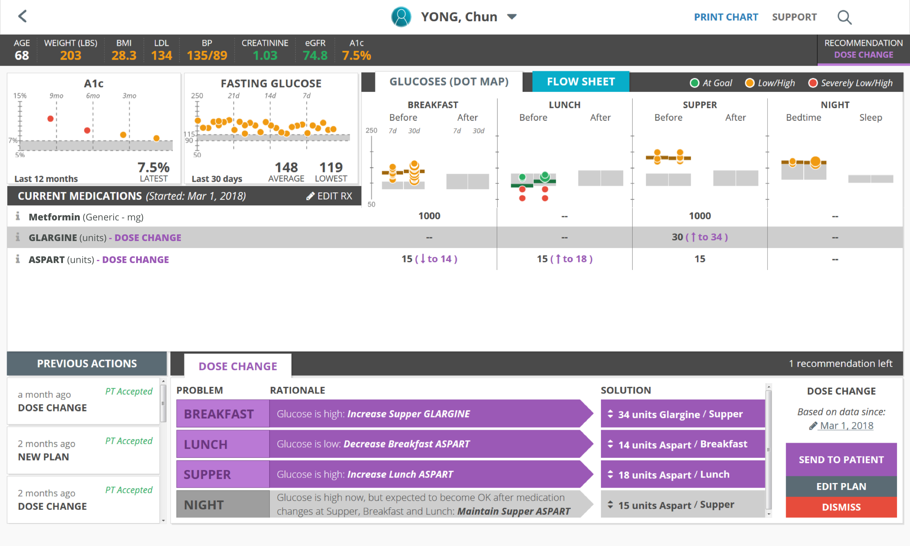
Physician’s Management Tool

Slide 20
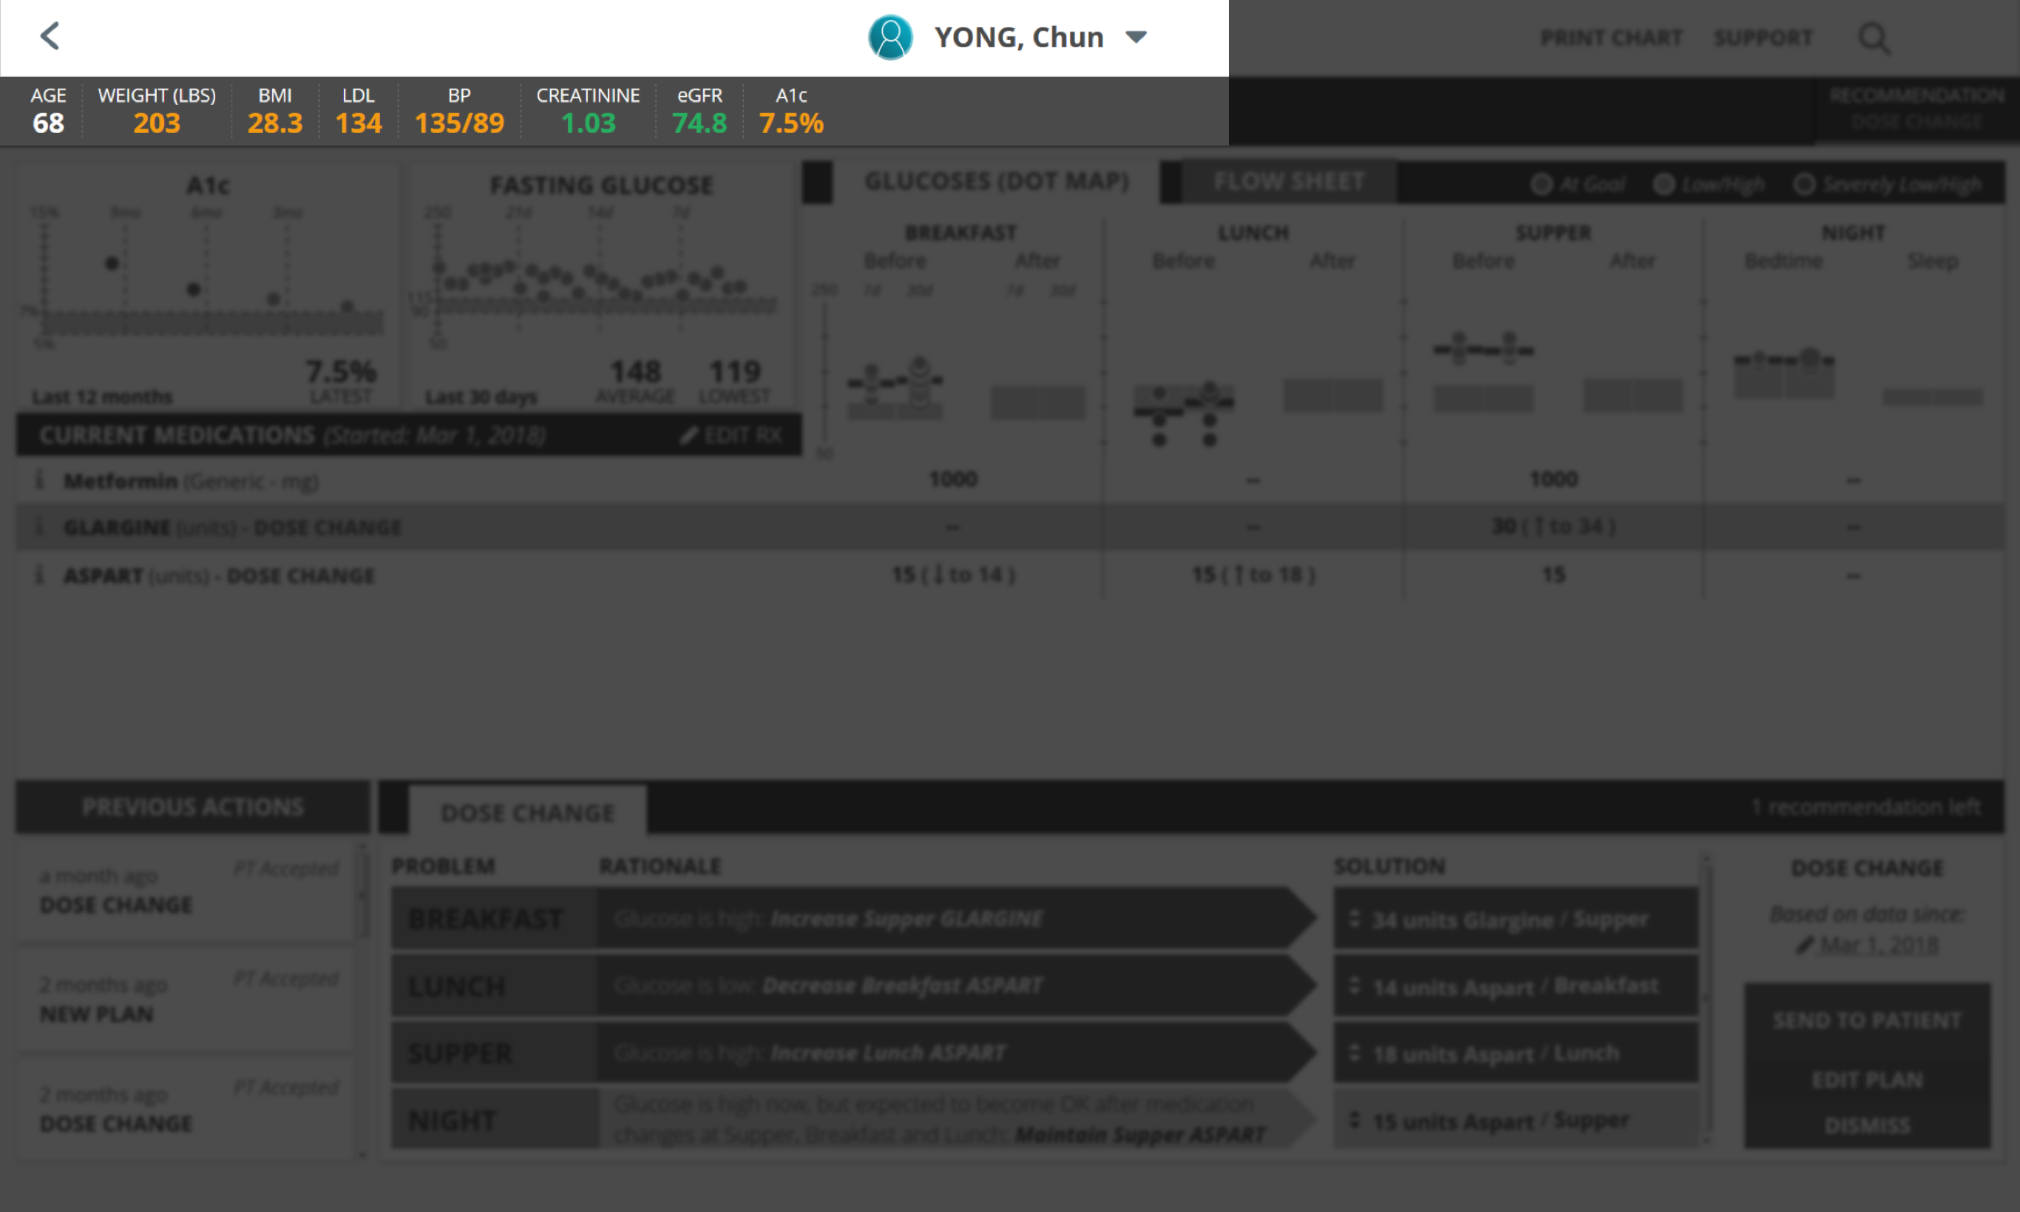
Physician’s Management Tool

Slide 21
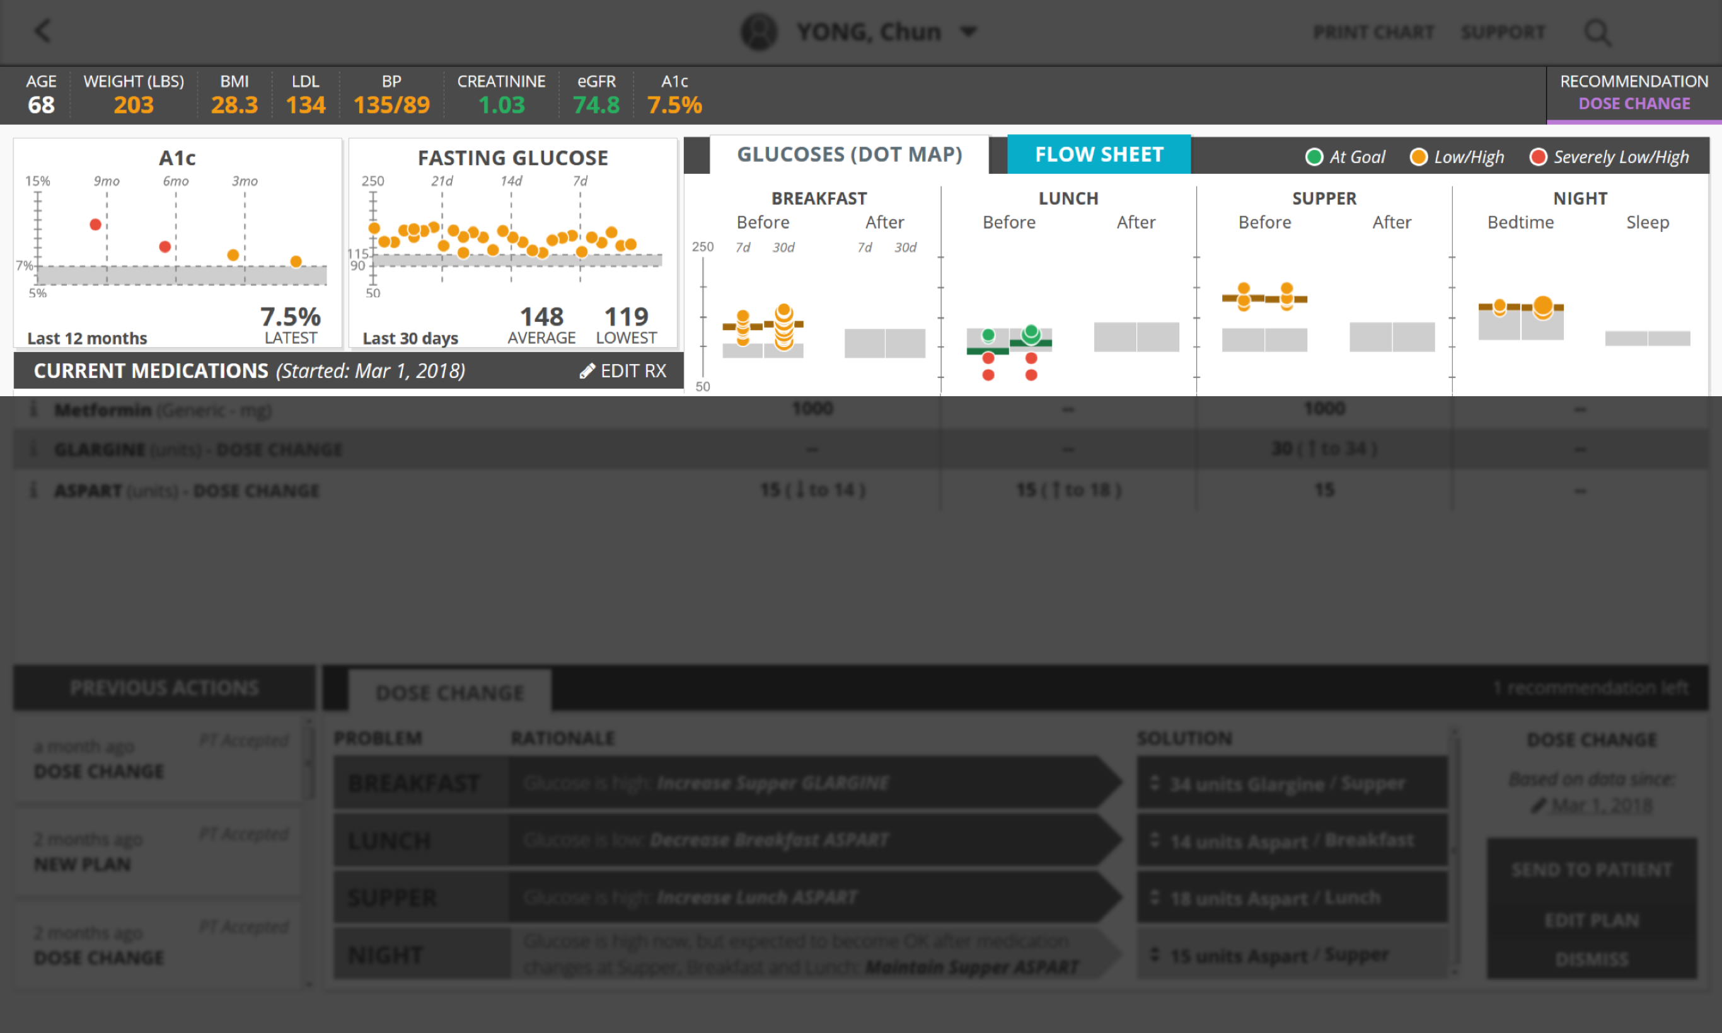
Physician’s Management Tool

Slide 22
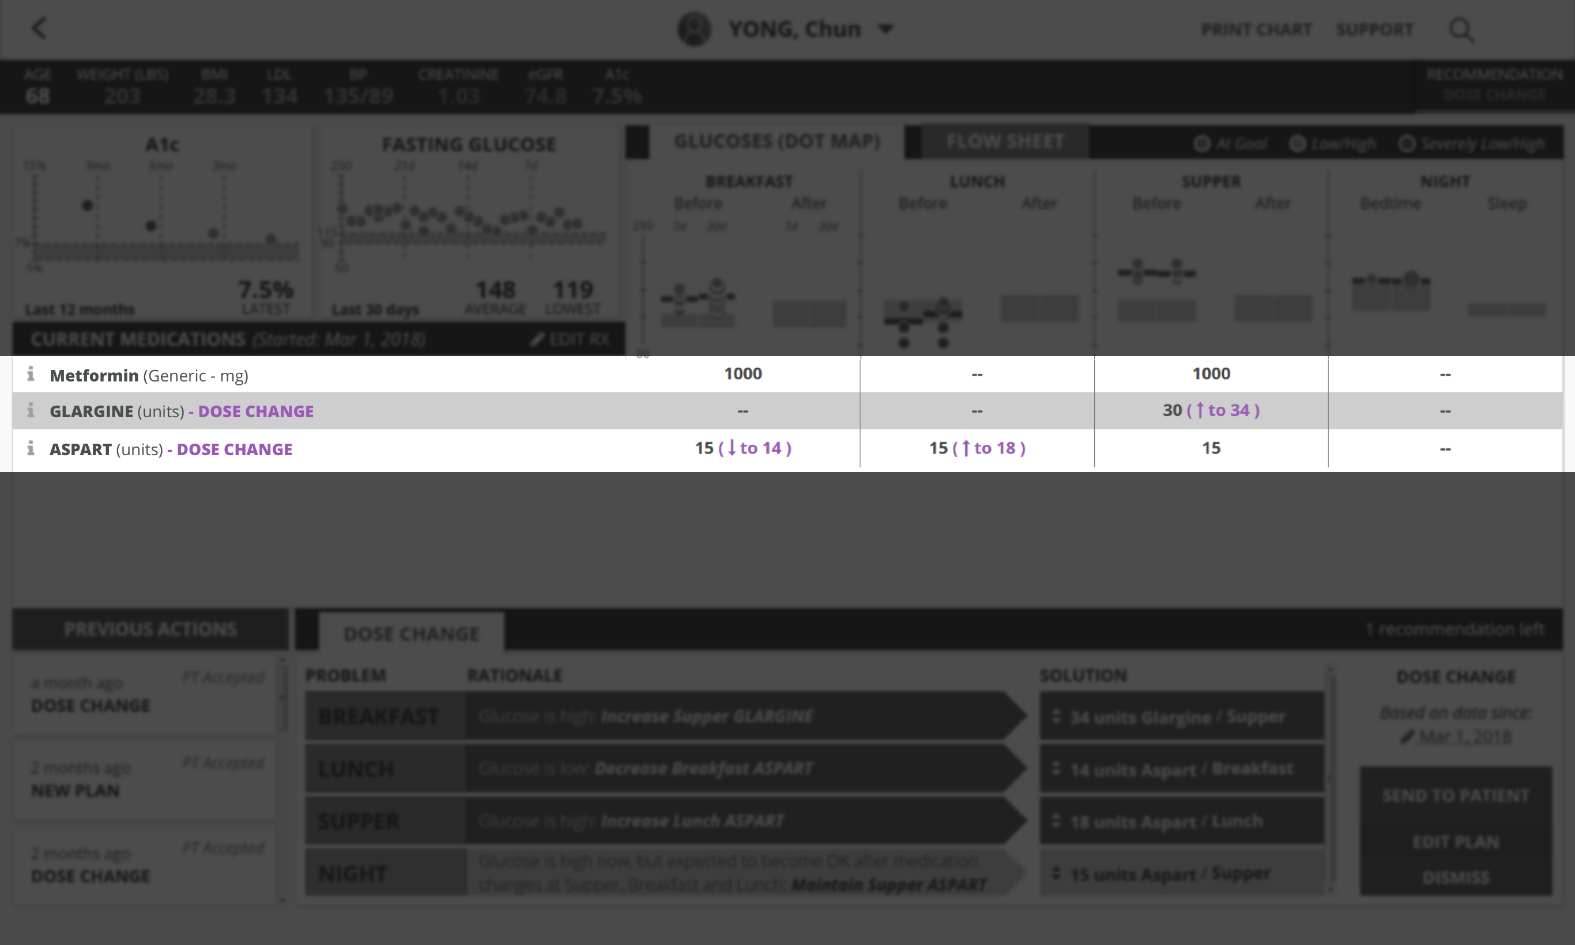
Physician’s Management Tool

Slide 23
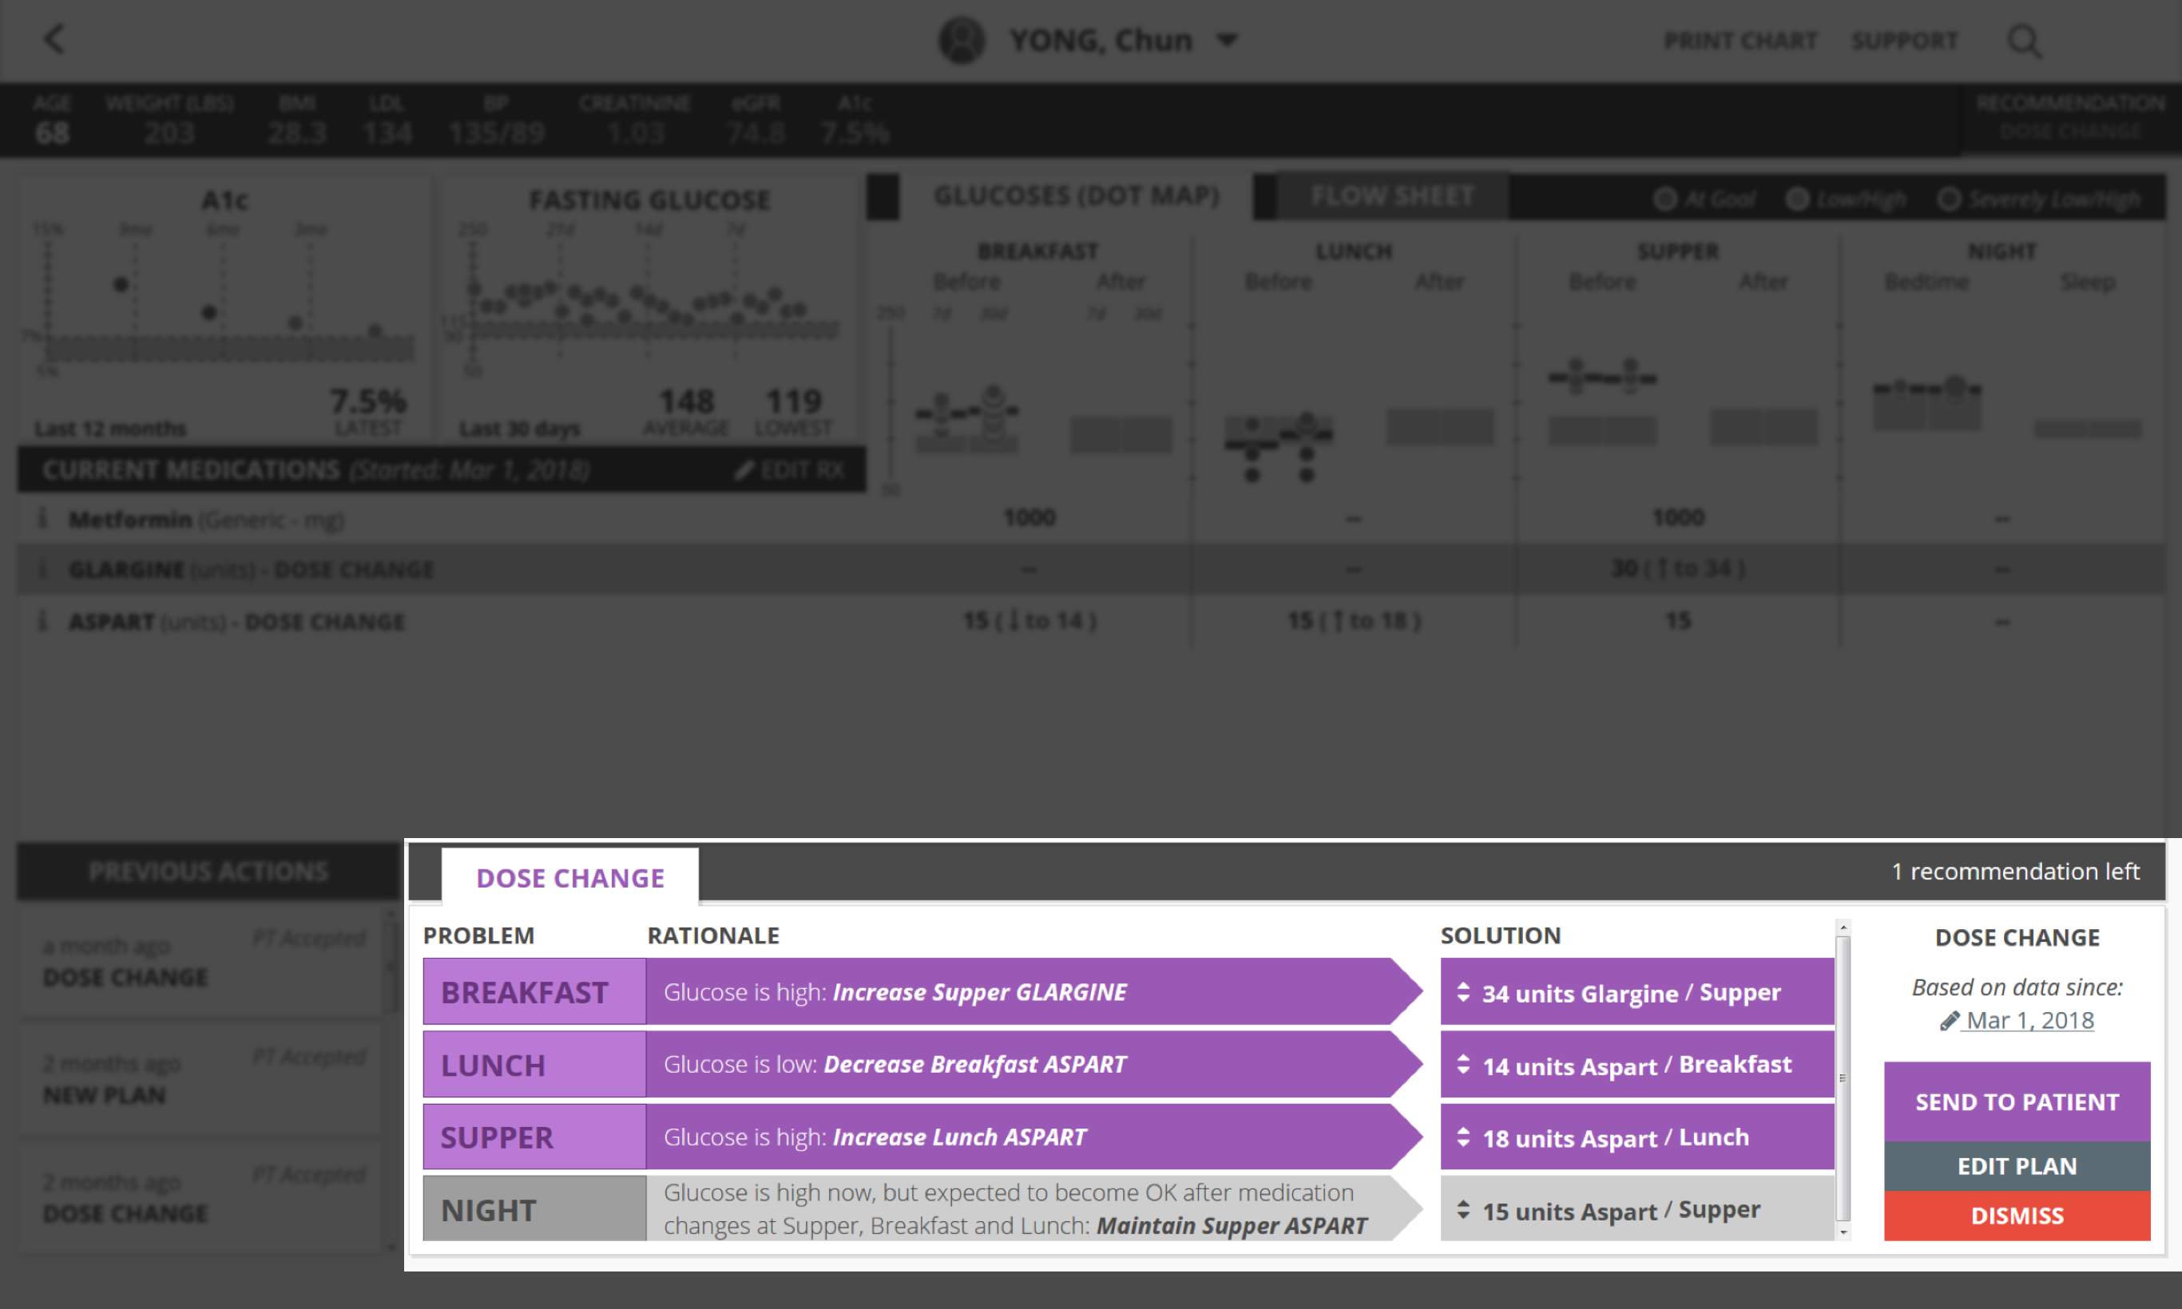
Physician’s Management Tool

Slide 24
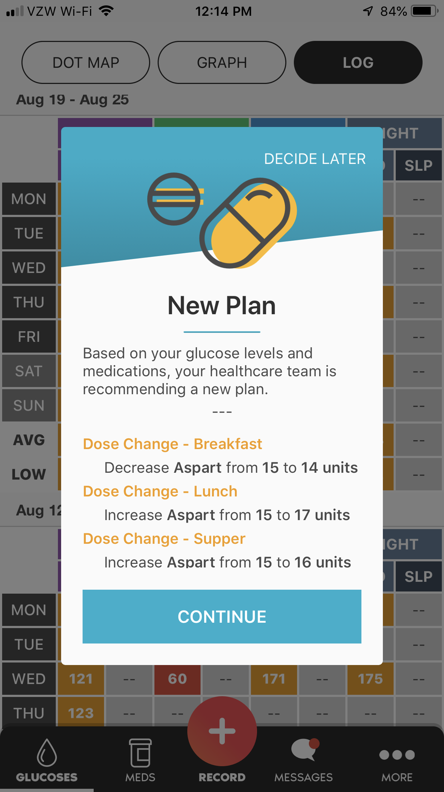
Patient Engagement Tool

Slide 25
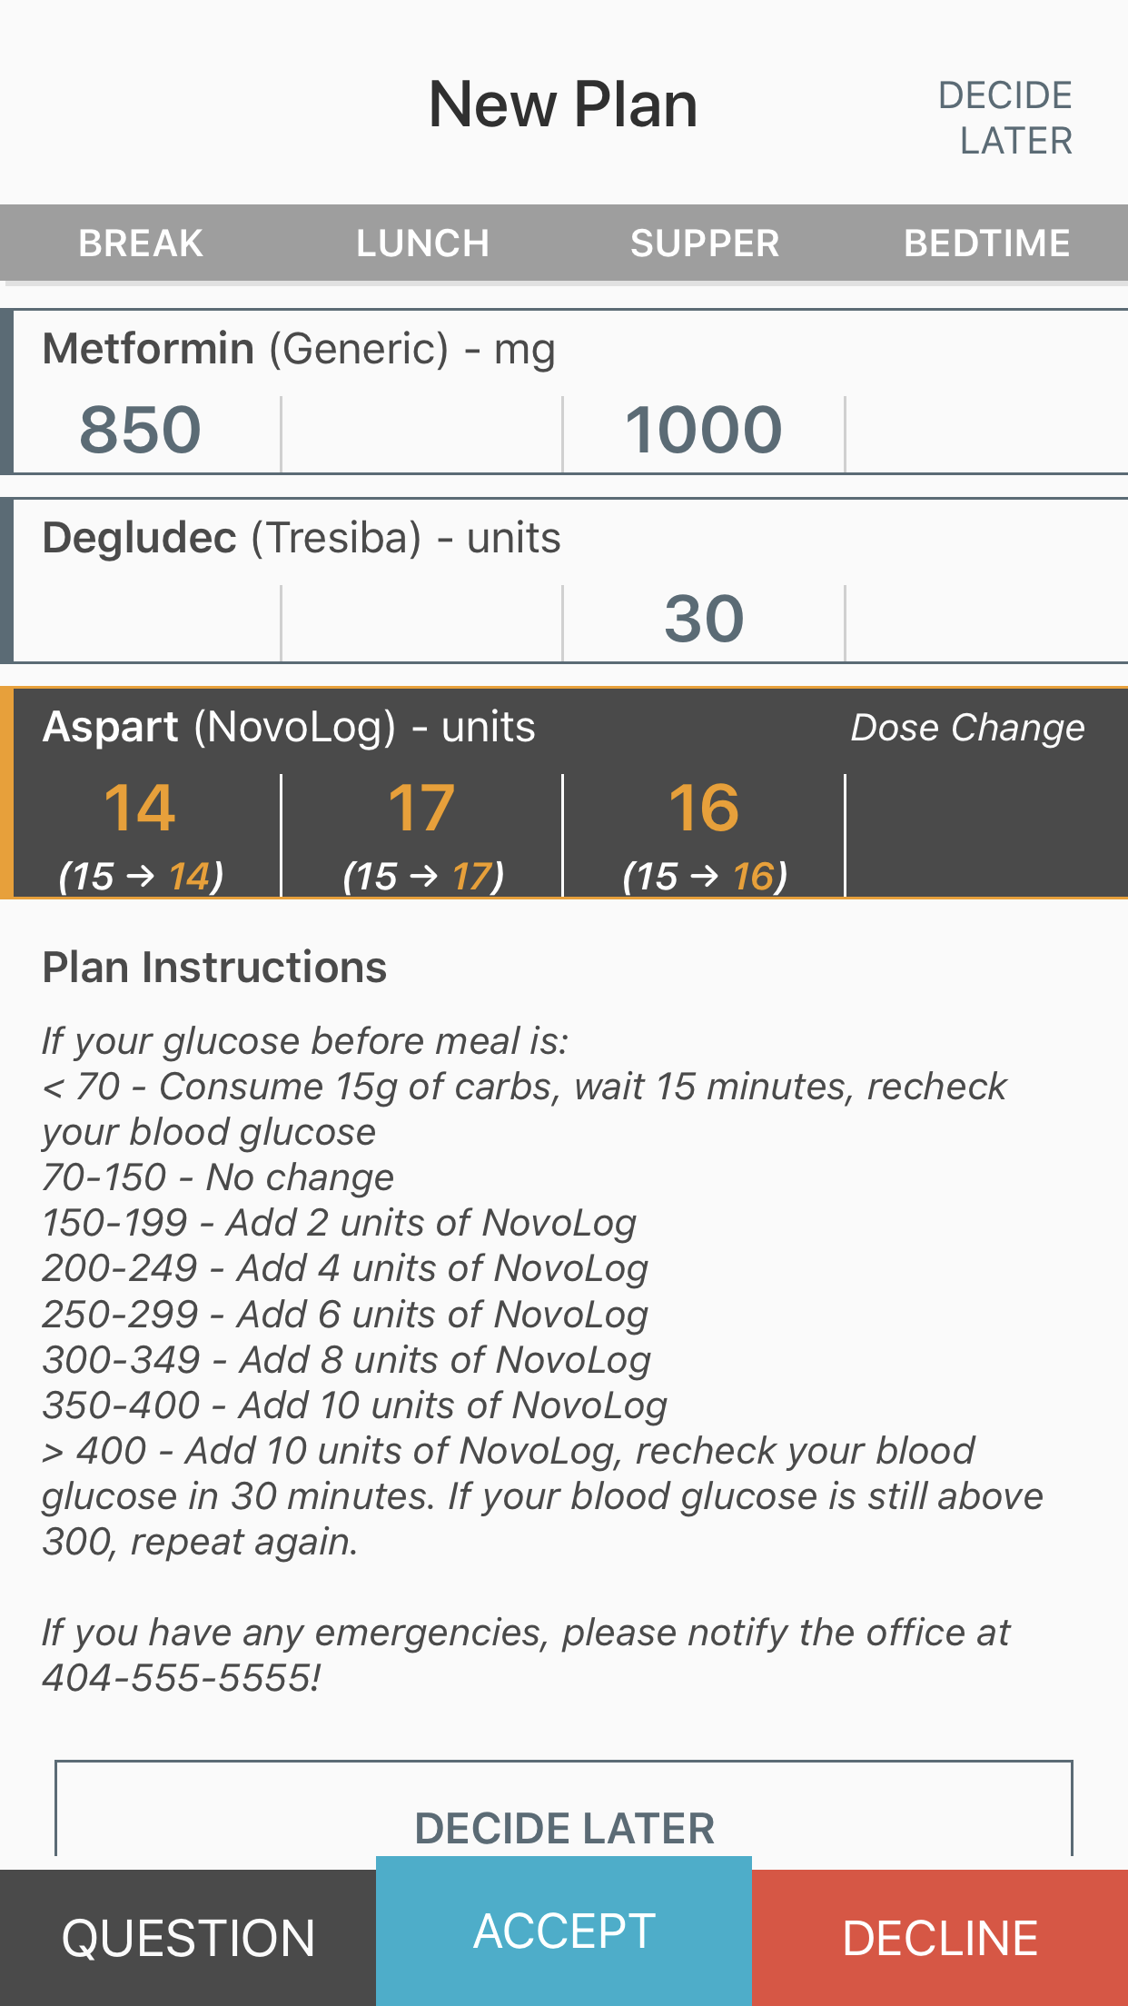
Patient Engagement Tool

Slide 26
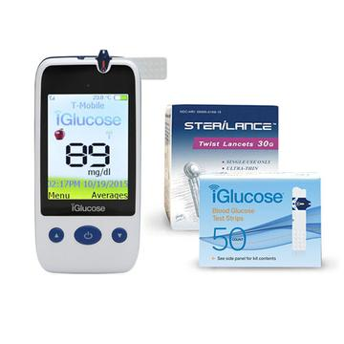
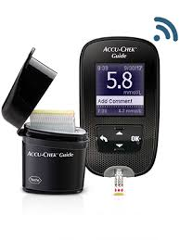
Integrated glucose monitoring devices allow seamless transmission of real-time data to providers for easy access, alerting, review, and clinical decision making.
Integration priorities based on customer demand.
Integrated Monitors
Completed
iGlucose
(recommended)
Accu-Chek
Guide
ReliOn
BLU
In the Pipeline
Fingerstick Glucose Meters:
Accu-Chek Aviva Plus
OneTouch Verio Flex
AgaMatrix Jazz Wireless
Contour Next One
Forna TN’G
iHealth Smart Meter
Keto-Mojo
Continuous Glucose Meters:
Abbott Libre
Dexcom
Eversense

Slide 27


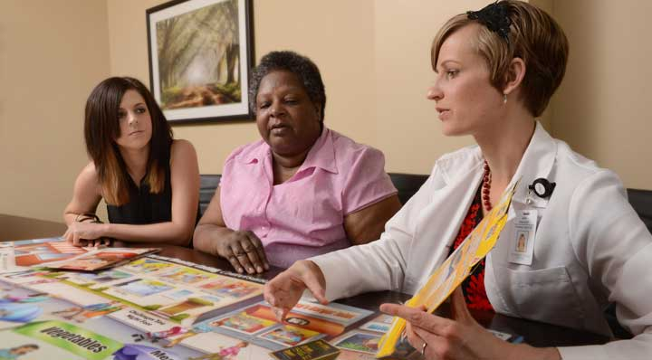
Physicians are often too busy to adopt new technologies, best practices, and payment models to improve care as needed for their patients.
We help recruit, train, and staff diabetes experts in physician offices to implement new diabetes approaches with positive financial ROI.
Clinical Staffing
Remote Patient Monitoring Services
Diabetes monitoring & management with Diasyst platform via CPT 99453, 99454, 99457.
CGM Services
Continuous glucose monitor setup and data review via CPT 95250, 95251.
Private Device Services
Setup, training, upgrade, and additional support for insulin pumps and other delivery devices.
Diabetes Self-Management Training
Individual and group sessions via G0108, G0109. *Accreditation by ADA or AADE required.

Slide 28

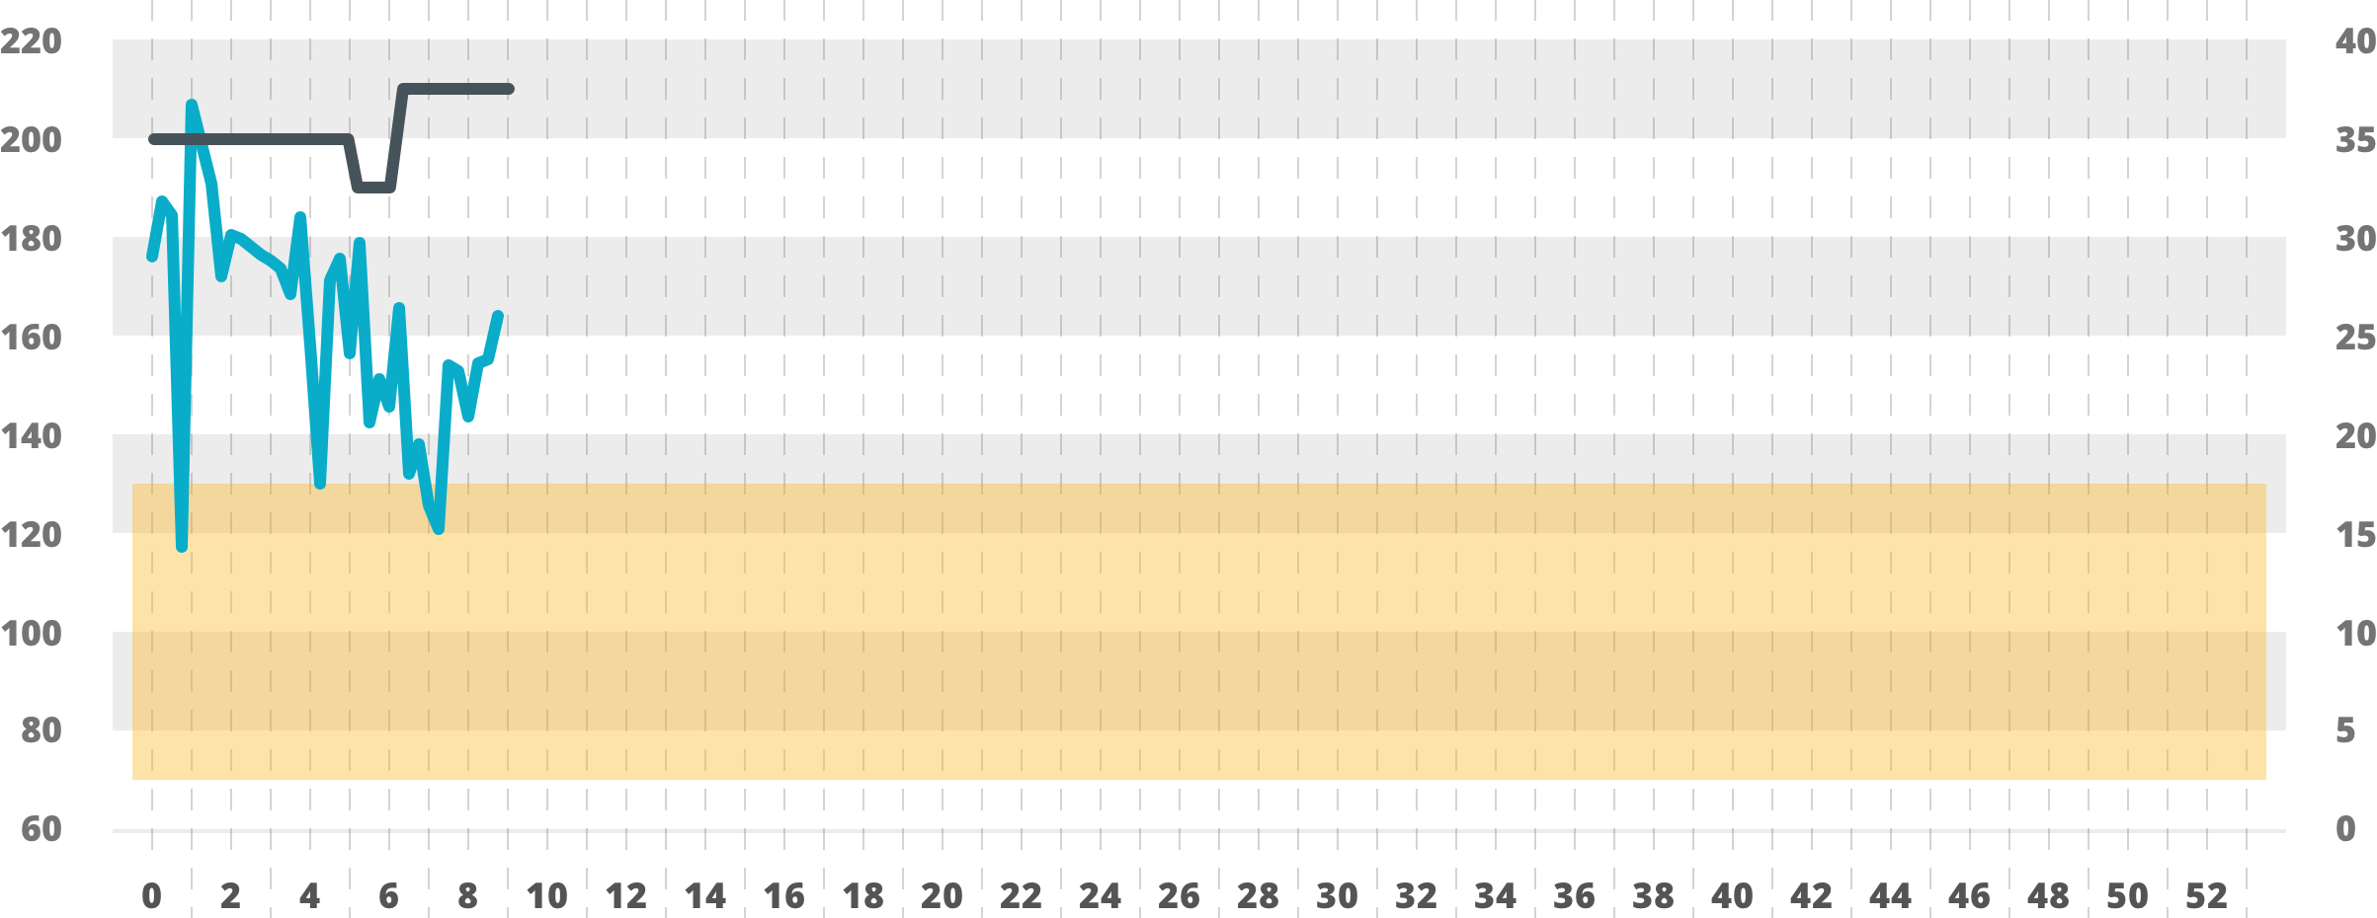
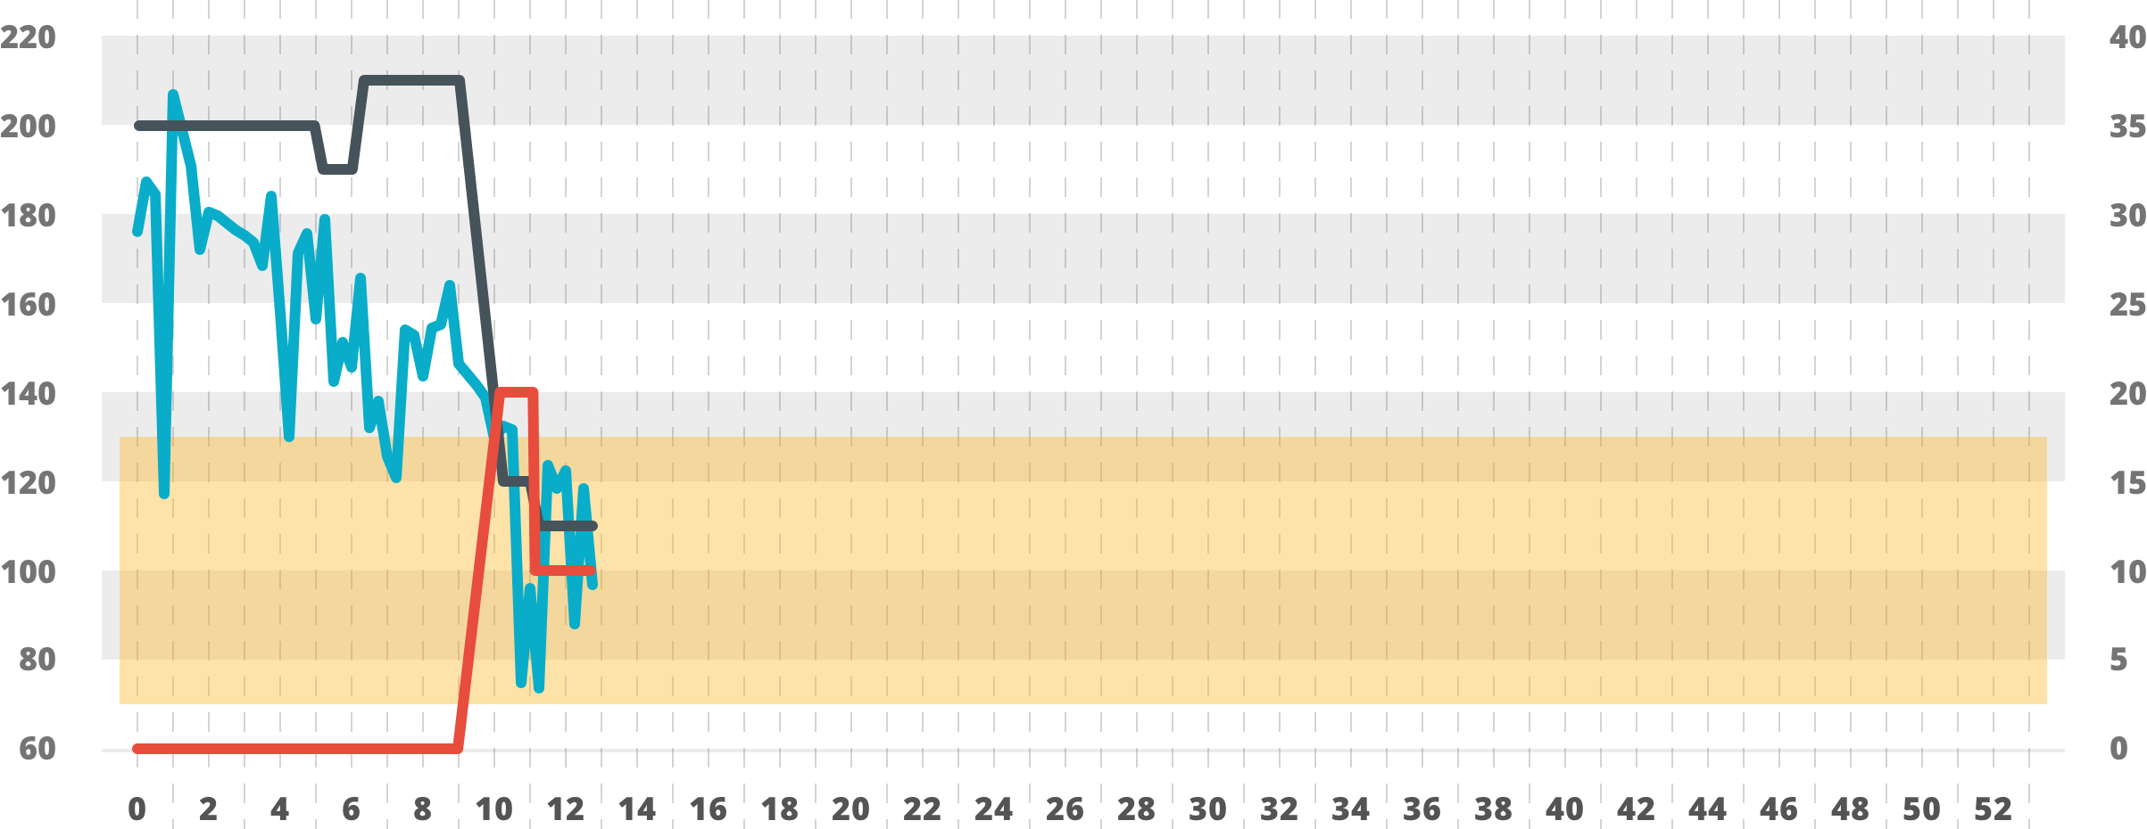
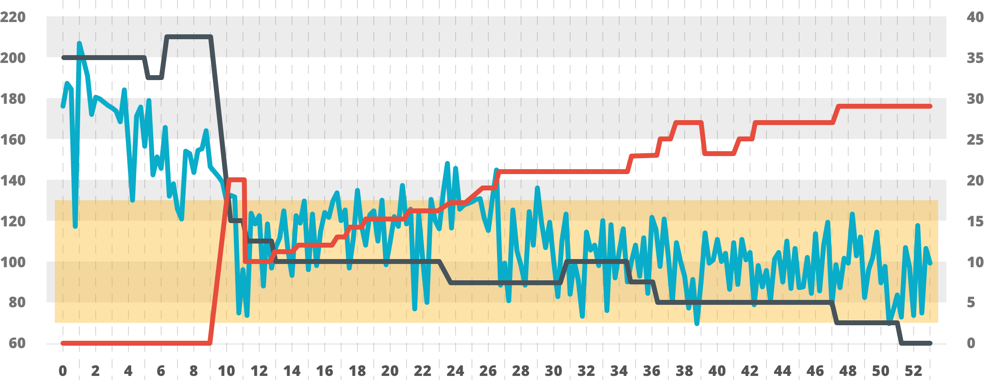



Analysis of a veteran managed with Diasyst
Medications adjusted – Glucoses remain at goal safely
Glipizide
New Medication added – Old Medication decreased to prevent hypoglycemia
Glucose high – Medication adjusted but glucose still above goal
Glucose Level
Med Doses (mg, units)
Glucose
GOAL RANGE
Insulin (Glargine)
Week
| Reference: Phillips, LS, J Diab Sci Tech 2015; 9(4): 857-64

Slide 29
Initial
POC
Results
A1c Improvements…
…With Little Hypoglycemia
After Diasyst
Before Diasyst
(Goal)
Very High Patient Engagement and Positive User Feedback
Limit Hypoglycemia to
Reduce ED Visits & Costs
Visible Glucose Improvement within 1 Month
Pharmacotherapy Approach Sustains Longer-Term Results (Compared to Behavior, Diet, Exercise-Based Approaches)
| Reference: Phillips, LS, J Diab Sci Tech 2015; 9(4): 857-64

Slide 30


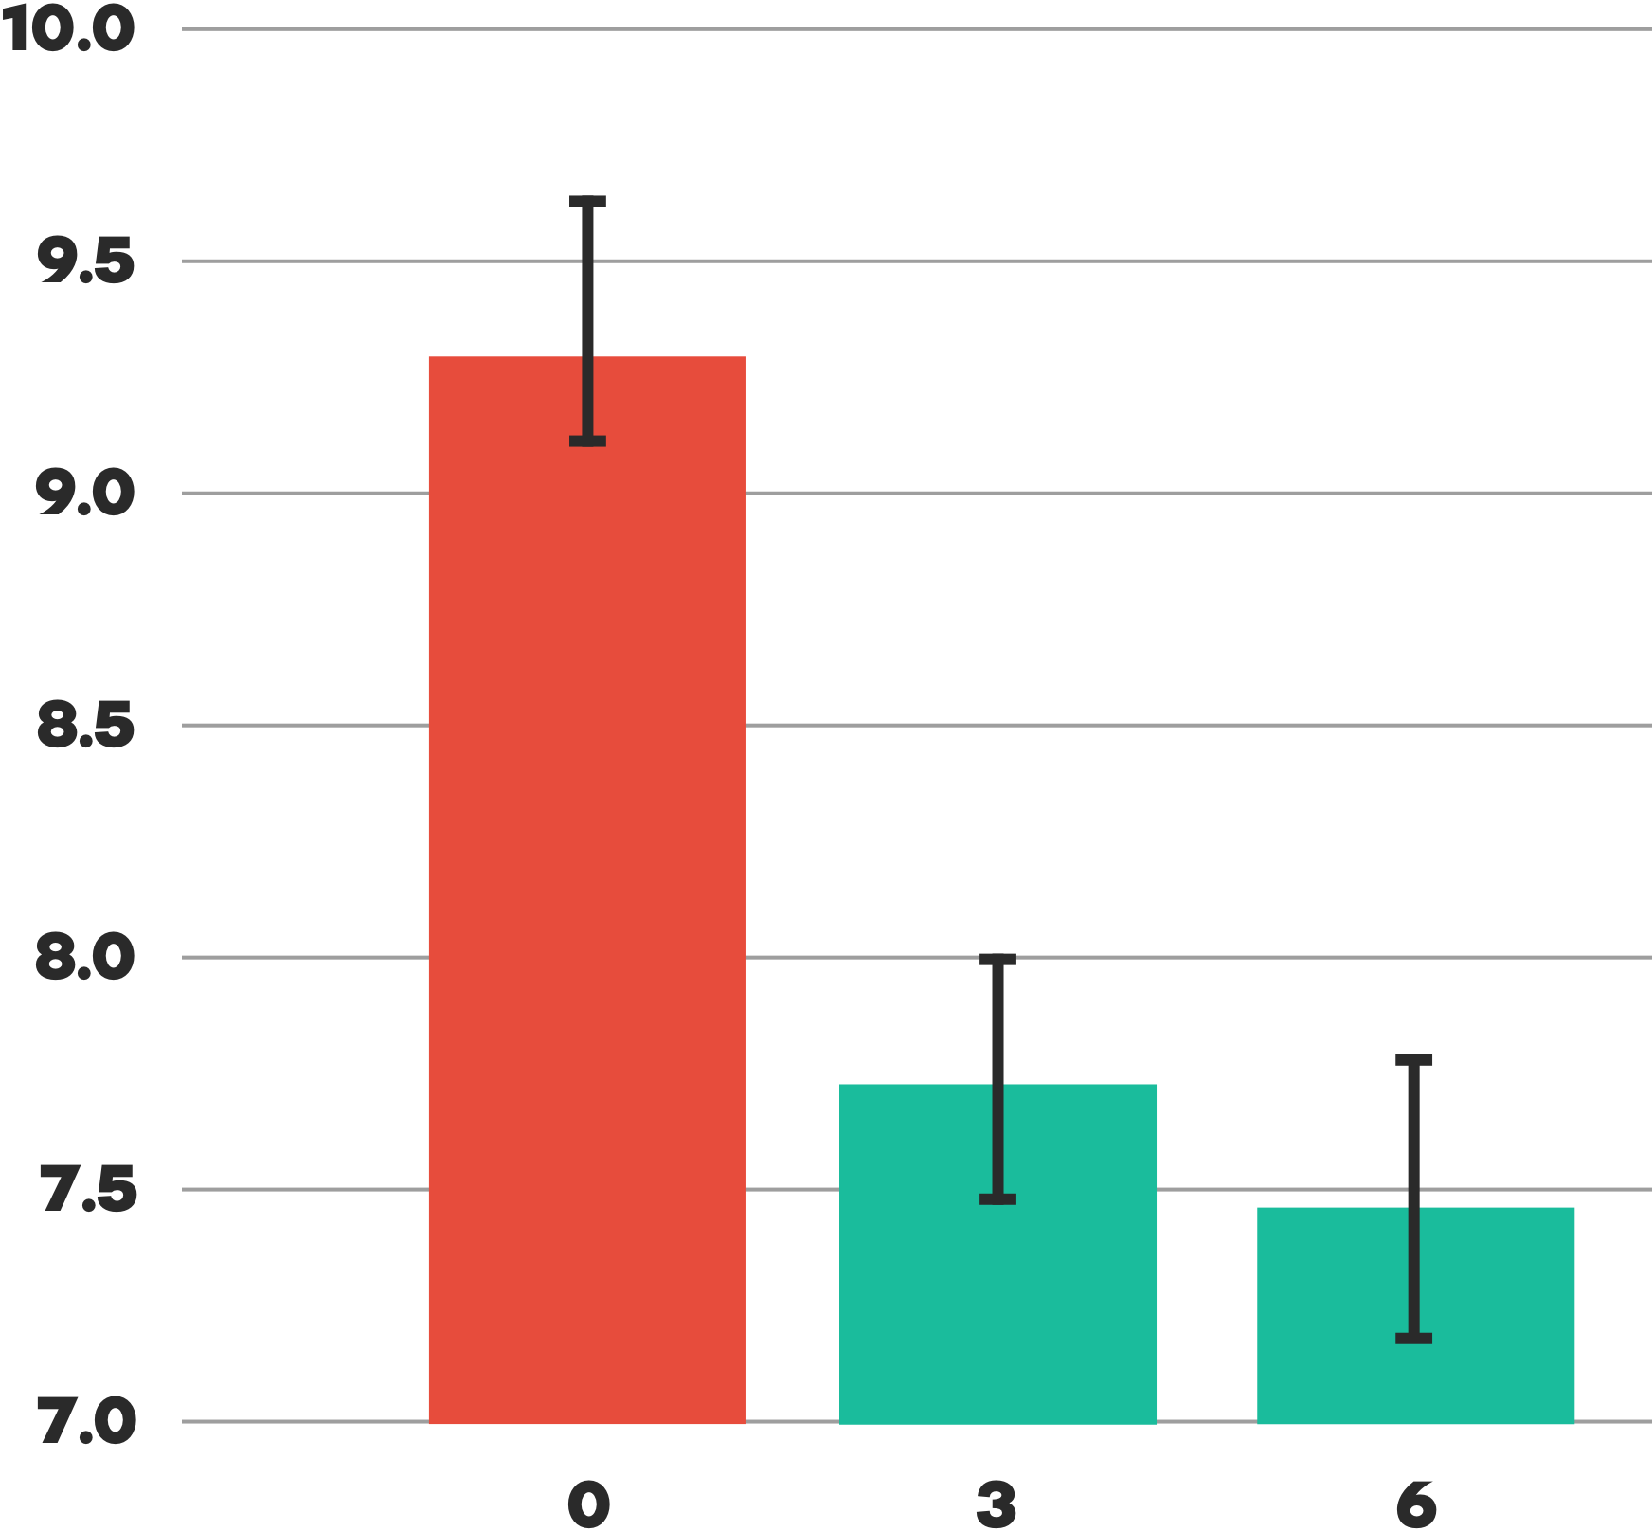
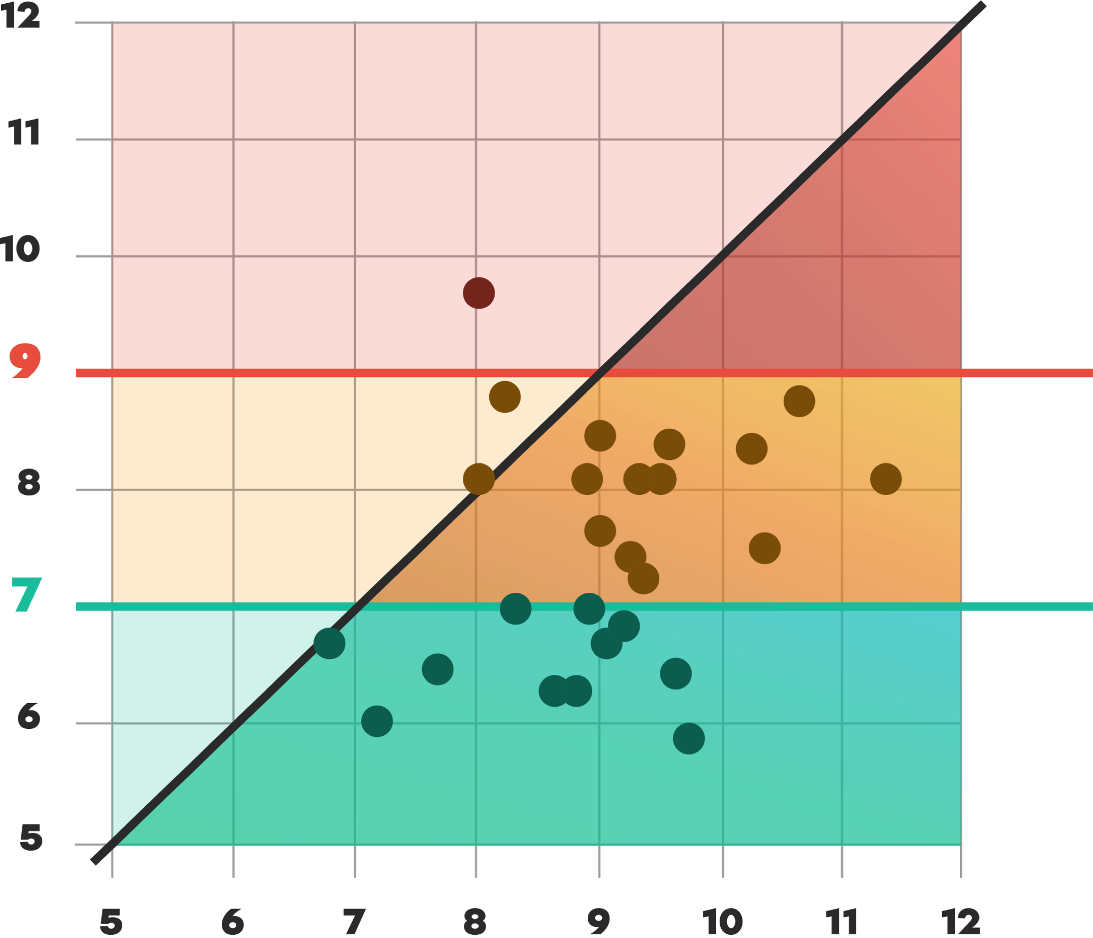
Results in the Real World
Results in the
^{1% A1c drop =}
44% reduction of complication risk
Average A1c (%)
ACO27/NQF0059 Poor Diabetes Control (>9% A1c)
A1c after 6 Months (%)
ADA Goal Good Diabetes Control (<7% A1c)
Month
Baseline A1c (%)

Slide 31


Results in the Real World
Results in the
By having the necessary information on a daily basis, Diasyst has saved us tremendous time on phone calls and allowed for more patient care in clinic. Patients benefit by knowing that accountability still exists, even when not being physically in the office.
1% drop = 44% reduction of complication risk
Average A1c (%)
ACO27/NQF0059 Poor Diabetes Control (>9% A1c)
A1c after 6 Months (%)
Ashley Allen, Diabetes Program Manager
ADA Goal Good Diabetes Control (<7% A1c)
Month
Baseline A1c (%)

Slide 32
Benefits of a Telediabetes Program in a Small, Independent Practice
Dr. Jason Berner
120 Oakside Ct, Suite H
Canton, GA 30114

Slide 33
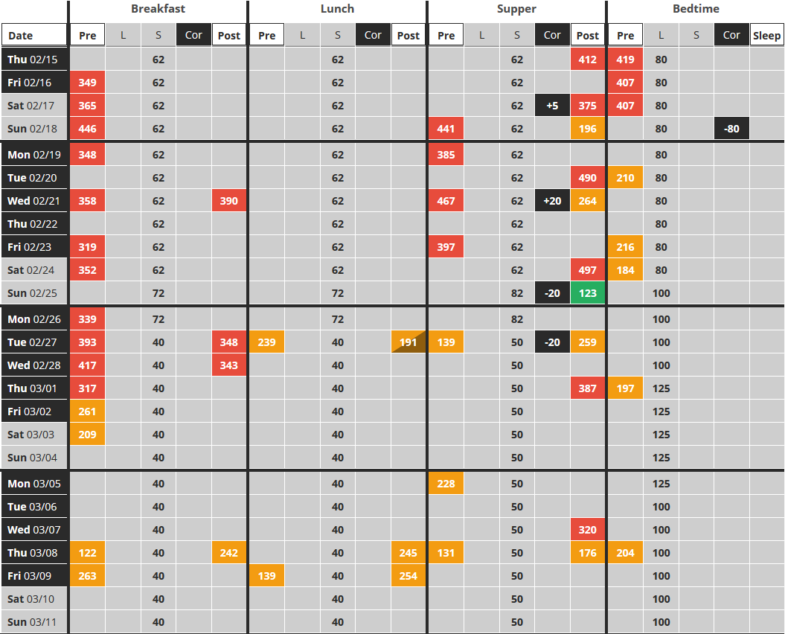
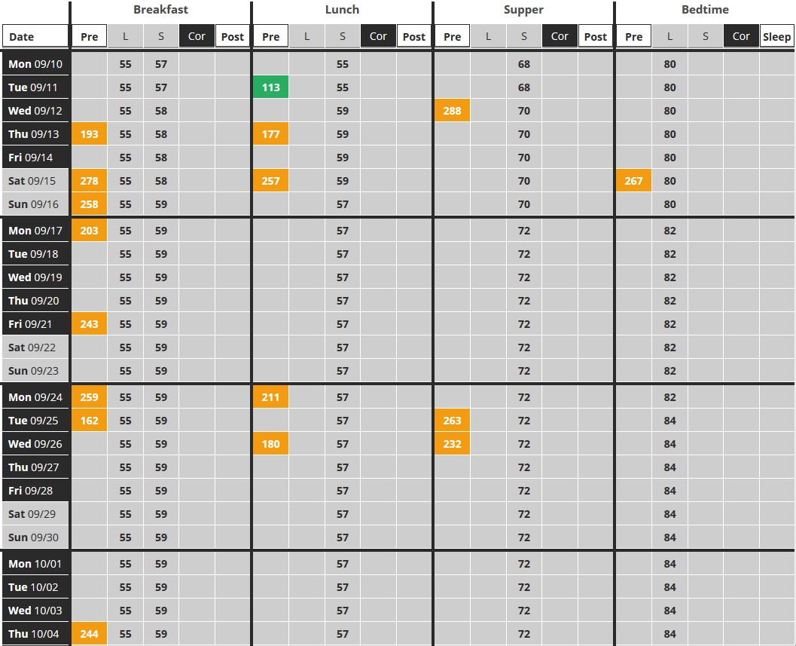
Patient Results (49yo M)
Reduce Extreme Highs

Slide 34
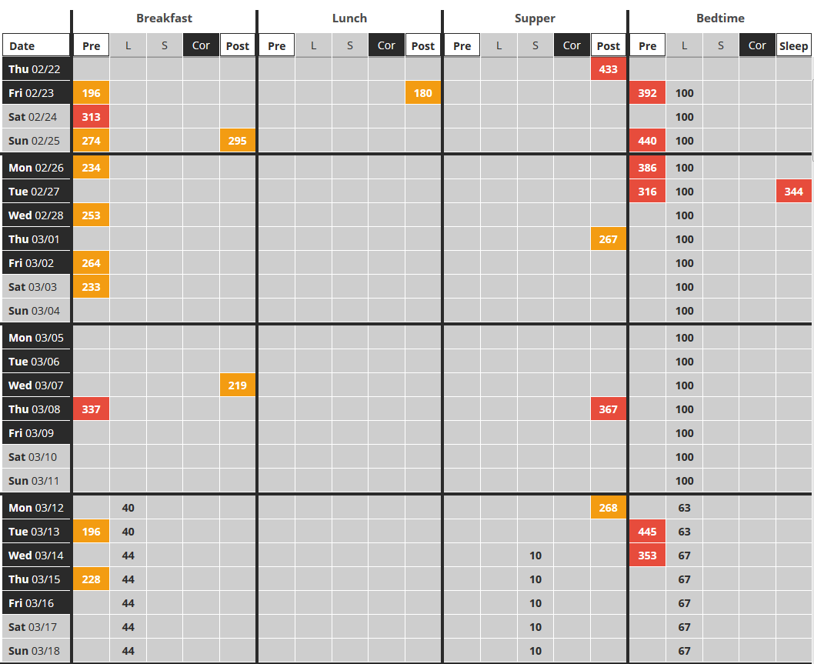
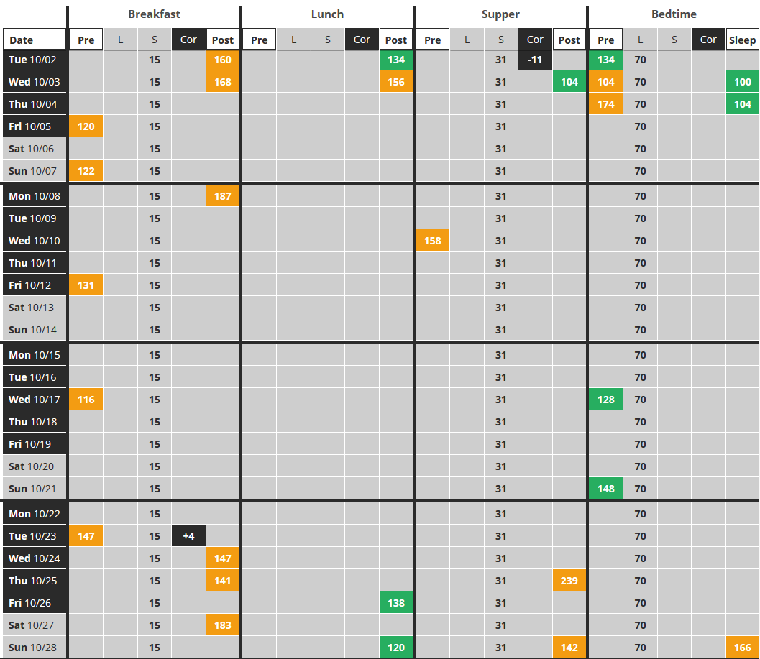
Patient Results (73yo M)
10.5% A1c → 7.7% (3mo)

Slide 35
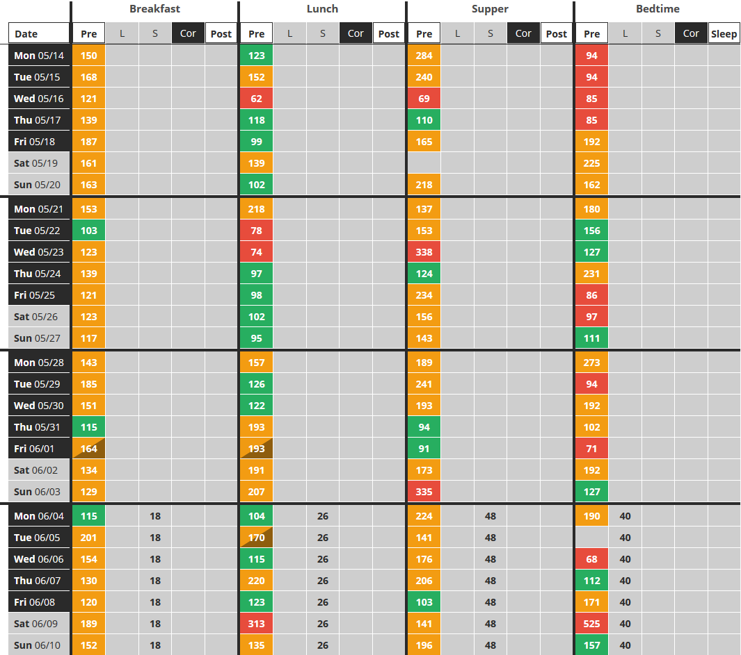
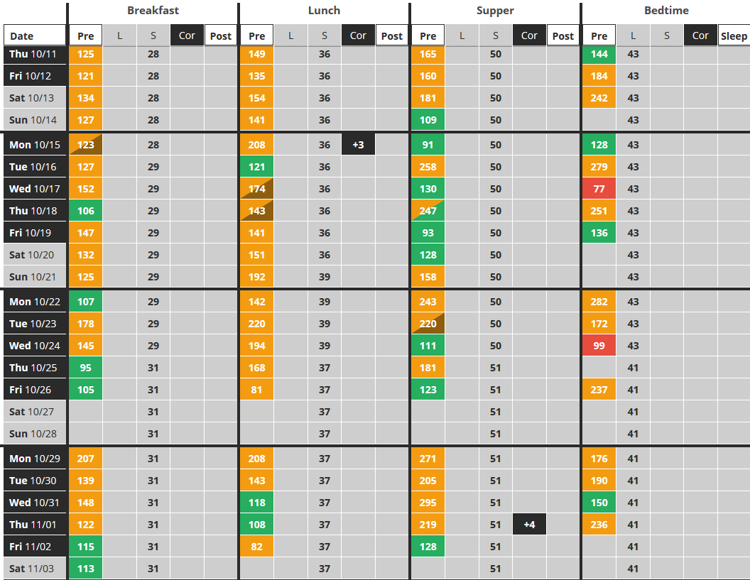
Patient Results (87yo M)
Reduce Hypoglycemia
7.6% A1c → 5.7%

Slide 36
Summary of Benefits
Substantially improved patient care
Increased patient engagement & compliance (testing & medications)
Increased patient safety (monitor progress, red flags, hypos)
More patient engagement and satisfaction
Increased access to patients, especially for remote patients
Additional, recurring revenue per patient
Streamlined existing office visits
Significant time-savings (data gathering)
Provider/staff convenience
Reimbursement for service and improved quality measures

Slide 37
So Does Telediabetes Work?
Heck Yes!

Slide 38

That’s $6,000 per patient per year!
Imagine the Opportunity in Georgia:
1.8m Medicaid patients
680,000 SHBP members
14% with type 2 diabetes
347,200 patients with diabetes under state care

Slide 39
Not all Unicorns and Rainbows

Slide 40
RPM Adoption Issues
Lack of awareness
Lack of payer reimbursement
Lack of reimbursement “proof”
High deductible healthcare plans (more patient responsibility)
Liability concerns
Lack of clinical resources
Fear of change

Slide 41
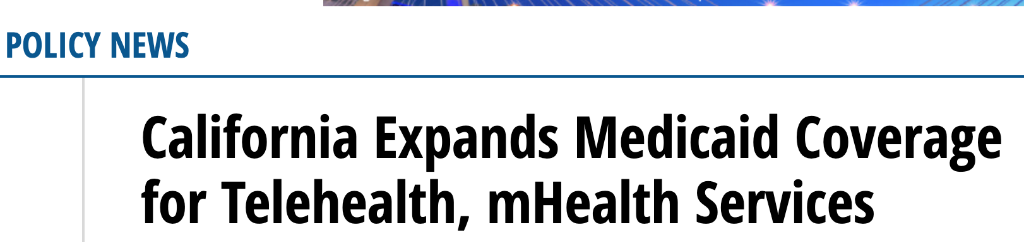
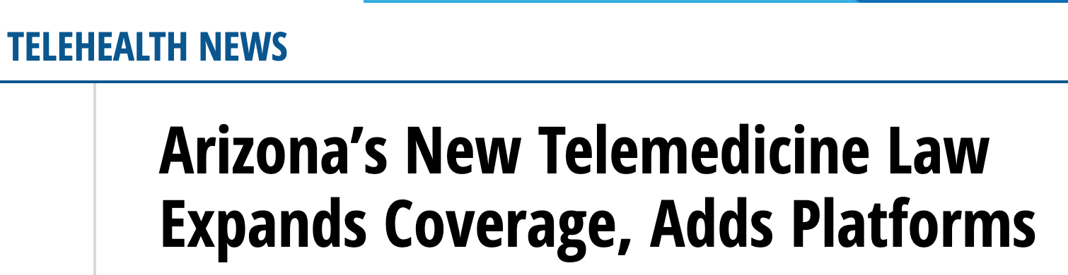
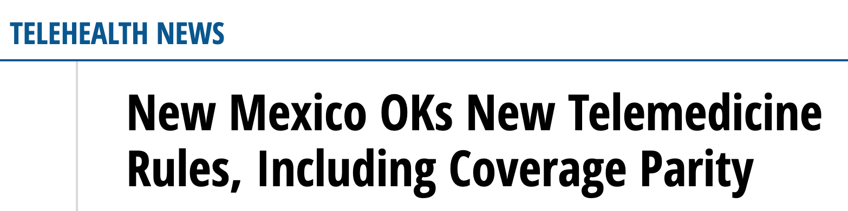
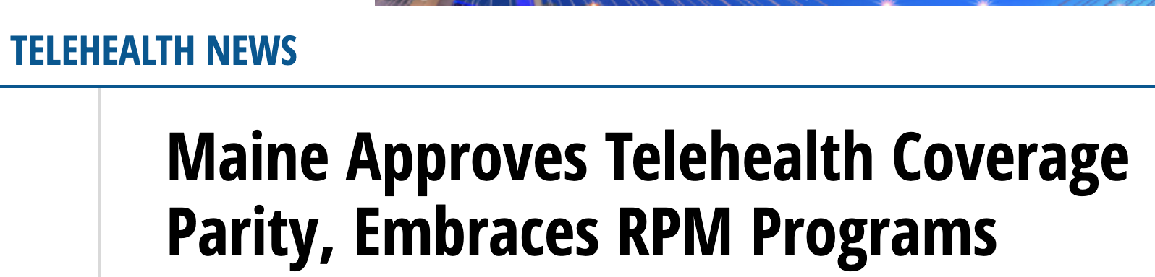
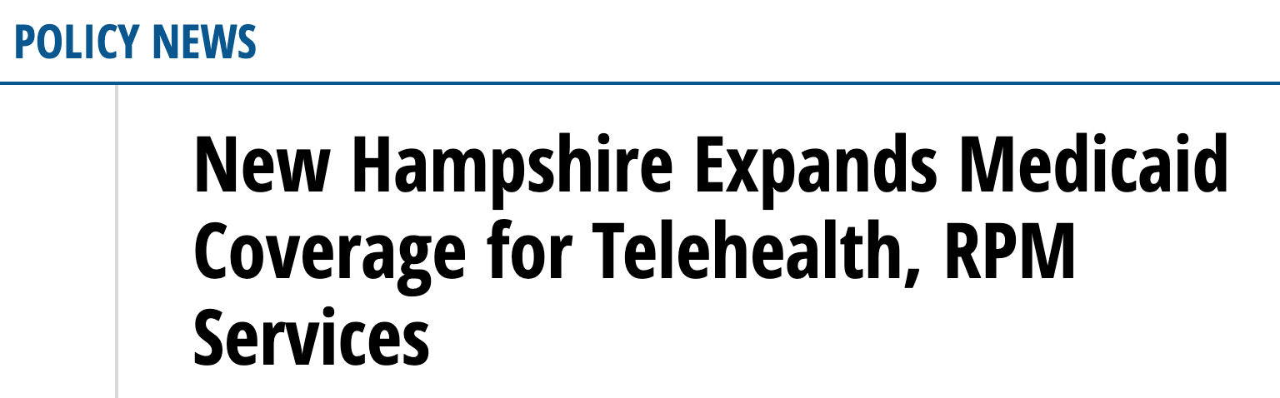
What you can do?
  Continue to support Georgia Research Alliance (GRA)
  Pass legislature to promote awareness and adoption of RPM and other virtual care solutions
  Fund RPM pilots for local clinics
  Support Georgia Healthcare Technology Innovation

Slide 42
What you can do?
Understand
Support
Start, Act, and Begin

Slide 43
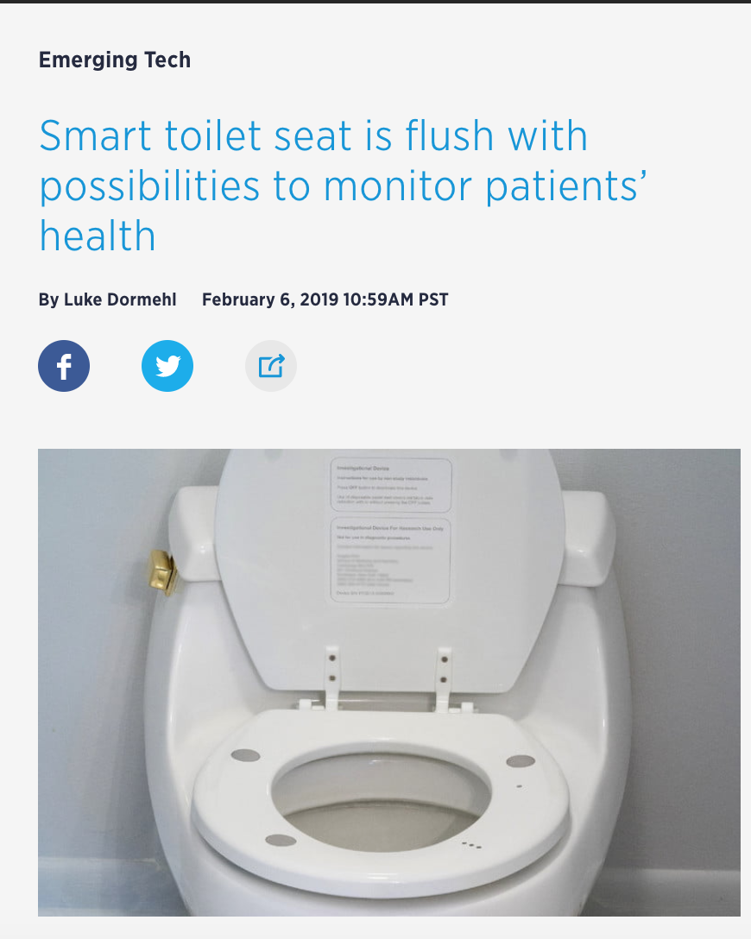

What you can do?
Understand
Support
Start, Act, and Begin

Slide 44
Let’s work together to help save Georgia lives
Tim Eggena
Chief Strategy Officer
tim@diasyst.com
(678) 595-1967

