Slide 1
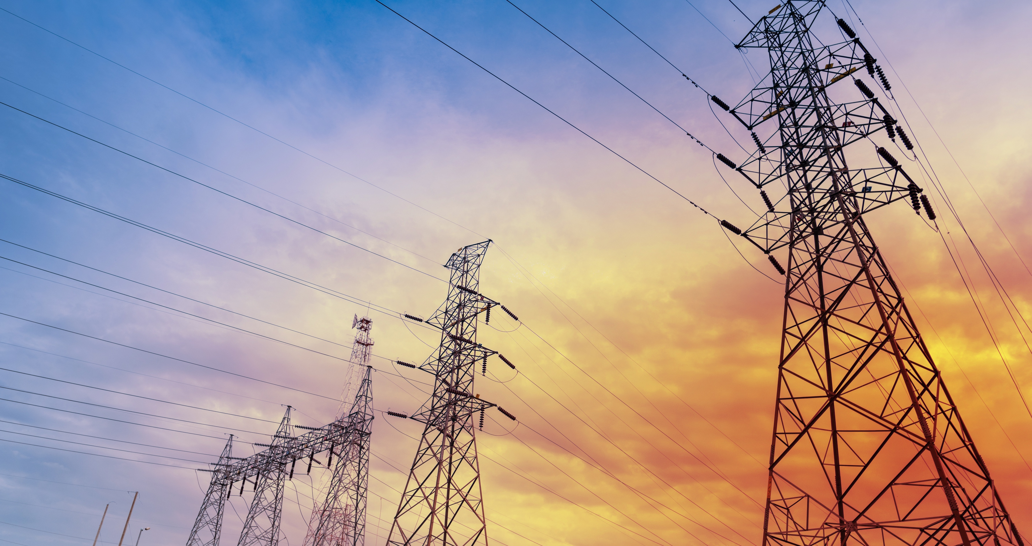
Registered Trademark and Trademark of Southwire Company, LLC.

Slide 2
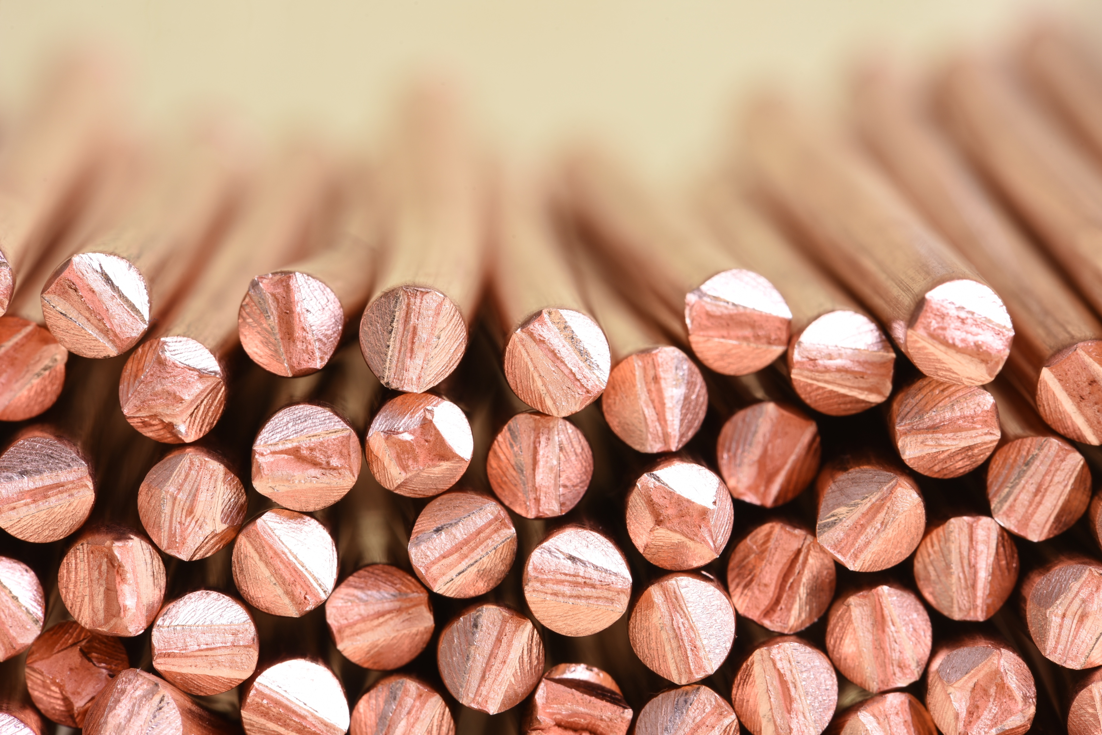


HALF OF THE WORLD'S COPPER ROD passes through a Southwire SCR® system
WE PRODUCE HALF of the wire and cable used to transmit and distribute electricity in the U.S.
HALF OF AMERICAN HOMES contain electrical wiring produced by Southwire
WE DELIVER…POWER

Slide 3
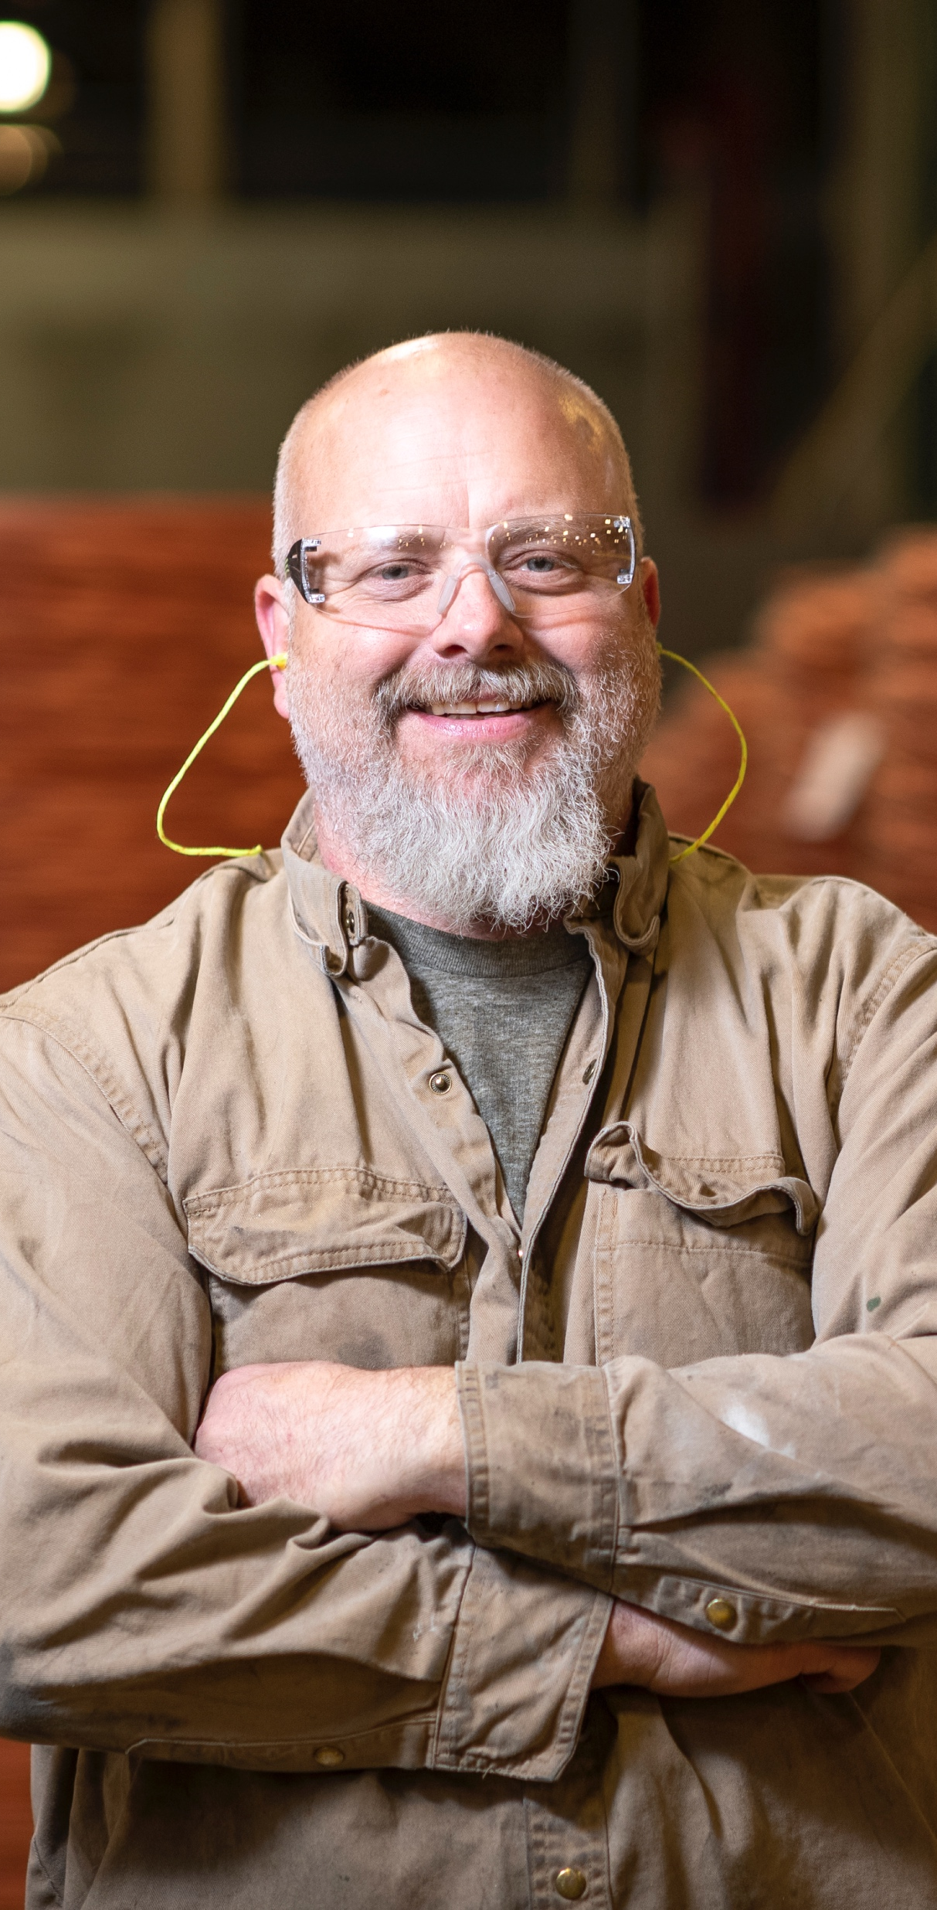
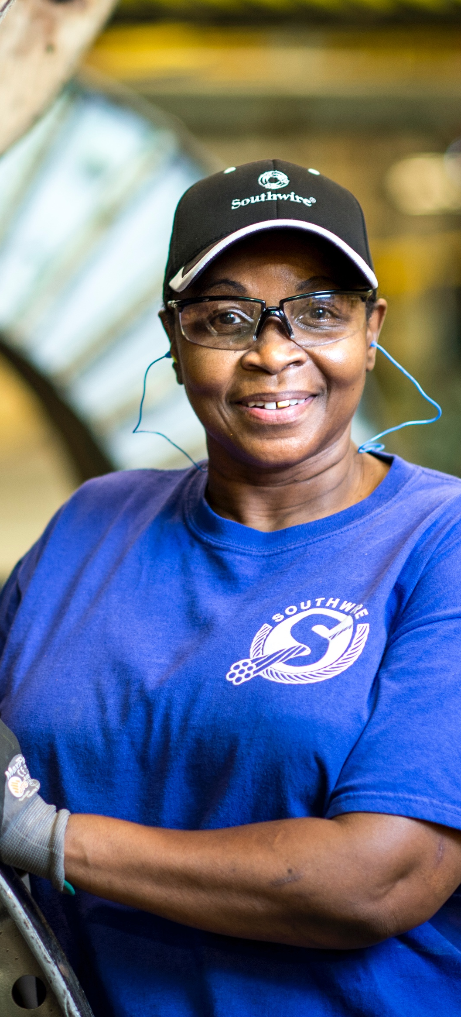

WE DELIVER…
AS ONE
Southwire is one of the world’s largest manufacturers of wire and cable and an emerging influence in the industrial electrical space.
$6.1 billion in revenue in 2018
WORKFORCE
FACILITIES
ORGANIZATION
Nearly 8,000 Employees
34 Plants
10 CSCs
Wire & Cable
Tools, Components & Assembled Solutions
Operations
Metals

Slide 4


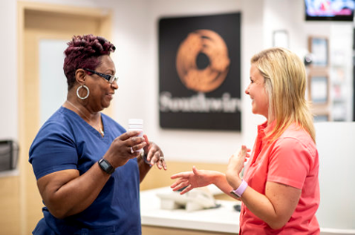



2019 Excellence Award
Care Management Strategies
WIGGINS
Family Medical Center Pharmacy

Slide 5
WE DELIVER…
INTEGRATION
2019 YTD Outcomes 309 Participants | A1C < 8% | Blood Pressure (<140/90 mmHg) | LDL <100mg/dl
Southwire Results | 94% | 89% | 85%
HEDIS 95th percentile | 65% | 75.67% | N/A
PHARMACIST
PHYSICIAN
PATIENT
Condition | Cohort Savings (PMPM) | Medication Adherence
Diabetes | $292 | 80.22%
Hypertension | $222 | 86.26%
Dyslipidemia | $118 | 87.09%

