Slide 1
Featurespace Presentation for
Lt. Governor's Task Force on Healthcare Access and Cost
September 5, 2019

Slide 2
FOUNDED-2008
A NEW WAY TO FIGHT RISK
Featurespace’s world leading invention,
Adaptive Behavioral Analytics, focuses on understanding customer behavior at a granular level – so fraudulent behaviour and suspicious activity stands out
30 YEARS OF RESEARCH
Prof. Bill Fitzgerald and David Excell
Inventors of Adaptive Behavioral Analytics
Working with
19 major banks globally
including 4 of the 5
leading banks in the U.K.
120 MILLION
consumers protected from fraud
and financial crime

Slide 3
|
Model Performance
Rules-Based Fraud Prevention
Rules-Based Fraud Prevention
Machine Learning Fraud Prevention
Featurespace Adaptive Behavioral Analytics
The main fraud prevention solutions available today show significant differences regarding their performance.
100
Rules-Based Fraud Prevention
Performance drops drastically as fraudsters change their MO
High maintenance costs
Difficult to manage due to the number of rules required and their complexity
Cannot prevent new types of fraud
80
New rule
60
Model Performance (%)
40
20
0
3
6
9
12
Time (Months)

Slide 4
|
Model Performance
Machine Learning Fraud Prevention
100
Traditional “Machine Learning” Fraud Prevention
Frequent retunes needed
Done quarterly or even yearly
Model performance may drop dramatically between retunes
Cannot react quickly to fraud attacks that happen shortly after retune
80
60
Model Performance (%)
40
Retune
Retune
20
0
3
6
9
12
Time (Months)
100
Featurespace Adaptive Behavioral Analytics
Self-learning models
No manual retuning required
Truly adaptive
80
60
Model Performance (%)
40
20
0
3
6
9
12
Time (Months)

Slide 5
Ultimately financial institutions want to protect their customers
so they build models around known fraud behavior to spot fraudulent activity
but in the process they can decline genuine transactions

Slide 6
A Different Approach

Slide 7
With this approach we can model “normal” behavior of everyone
…this way the bad behavior stands out like a sore thumb
Even stopping criminals when they use new, unknown methods
Reducing the number of genuine customers inconvenienced

Slide 8
How ARIC™ Works
Data Inputs
Behavioral Profiles
Behavioral Profiles
Processing Engine
Case Management
Real-Time Feedback Loop
Patients
Individual Profile
Change Detection
Context Profile
Treatments
Individual Profile
Change Detection
Prediction
Context Profile
Providers
Individual Profile
Change Detection
Context Profile

Slide 9
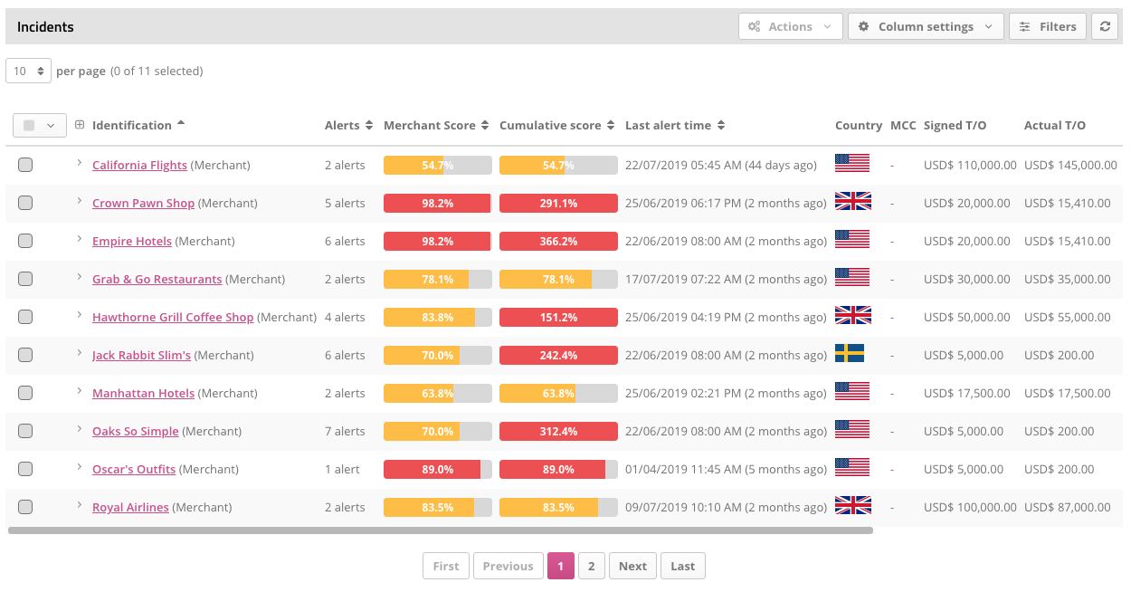
How ARIC™ Works
Data Inputs
Behavioral Profiles
Processing Engine
Case Management
Case Management
Real-Time Feedback Loop

Slide 10
GLOBAL CREDIT CARD ISSUER
Number of False Positives
10:1
False Positive Ratio Overall
20K
23:1
False Positive Ratio (CNP)
15K
100%
Total Fraud Loss
10K
Show performance
5K
Existing System
Adaptive Behavioral Profiling
0
01 Feb
08 Feb
15 Feb
22 Feb
01 Mar

Slide 11
GLOBAL CREDIT CARD ISSUER
^{Card Not Present Fraud}
A card not present transaction (CNP, MO/TO, Mail Order / Telephone Order, MOTOEC) is a payment card transaction made where the cardholder does not or cannot physically present the card for a merchant's visual examination at the time that an order is given and payment effected, such as for mail-order transactions by mail or fax, or over the telephone or Internet.
Card not present transactions are a major route for credit card fraud, because it is difficult for a merchant to verify that the actual cardholder is indeed authorizing a purchase.
If a fraudulent CNP transaction is reported, the acquiring bank hosting the merchant account that received the money from the fraudulent transaction must make restitution; whereas with a swiped (card present) transaction, the issuer of the card is liable for restitution.
Number of False Positives Using Adaptive Behavioral Analytics in Real-Time
10:1
3:1
False Positive Ratio Overall
20K
23:1
6:1
False Positive Ratio (CNP)
15K
70%
80%
39%
100%
61%
Total Fraud Loss
10K
Reduction in Genuine Transactions Declined
Reduction in Genuine Transactions Declined (CNP)
Reduction in Fraud Losses
Show performance
5K
Existing System
Adaptive Behavioral Profiling
0
01 Feb
08 Feb
15 Feb
22 Feb
01 Mar

Slide 12
GLOBAL CREDIT CARD ISSUER
Time to detection and incurred losses
Detection of a specific fraud attack by the Global Credit Card Issuer
28 HOURS
20K
To Manual Detection
15K
$321,000
Fraud Loss
10K
Show performance
5K
Existing System
Adaptive Behavioral Profiling
0
01 Feb
08 Feb
15 Feb
22 Feb
01 Mar

Slide 13
GLOBAL CREDIT CARD ISSUER
^{Card Not Present Fraud}
A card not present transaction (CNP, MO/TO, Mail Order / Telephone Order, MOTOEC) is a payment card transaction made where the cardholder does not or cannot physically present the card for a merchant's visual examination at the time that an order is given and payment effected, such as for mail-order transactions by mail or fax, or over the telephone or Internet.
Card not present transactions are a major route for credit card fraud, because it is difficult for a merchant to verify that the actual cardholder is indeed authorizing a purchase.
If a fraudulent CNP transaction is reported, the acquiring bank hosting the merchant account that received the money from the fraudulent transaction must make restitution; whereas with a swiped (card present) transaction, the issuer of the card is liable for restitution.
Time to detection and incurred losses
Detection of the same specific fraud attack by ARIC Fraud Hub
1 MINUTE
20K
To Automatic Detection
15K
$115,000
Fraud Loss
10K
Show performance
5K
Existing System
Adaptive Behavioral Profiling
0
01 Feb
08 Feb
15 Feb
22 Feb
01 Mar

