Slide 1
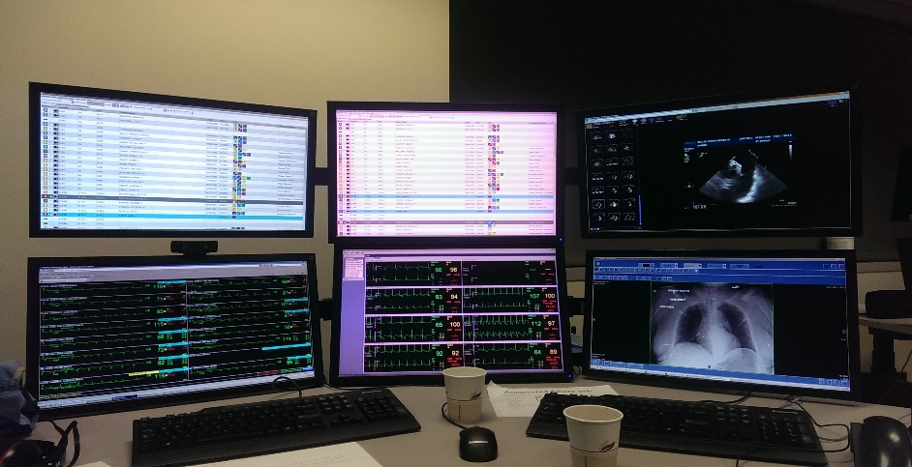
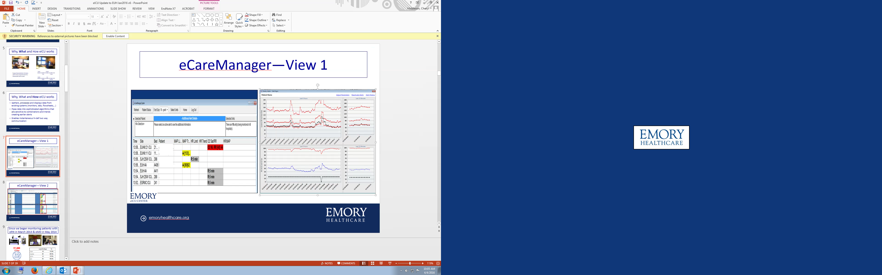
Lt. Governor's Task Force on Healthcare Access and Cost
Cheryl Hiddleson
MSN, RN, CENP, CCRN-E
Director, Emory eICU Center
9 October, 2019
Disclosures: None

Slide 2

The Emory Program:
eRNs: 24 x 7 x 365
eMDs: nights weekends and holidays
Industry standard convergent eICU platform
Multiple EMR, physiologic monitors
13 locations, 150 beds in 4 hospitals
(2 university, 1 hybrid, 1 community)
Since Mar 2013
37,694 UNIQUE PATIENTS
124,919 PATIENT DAYS

Slide 3
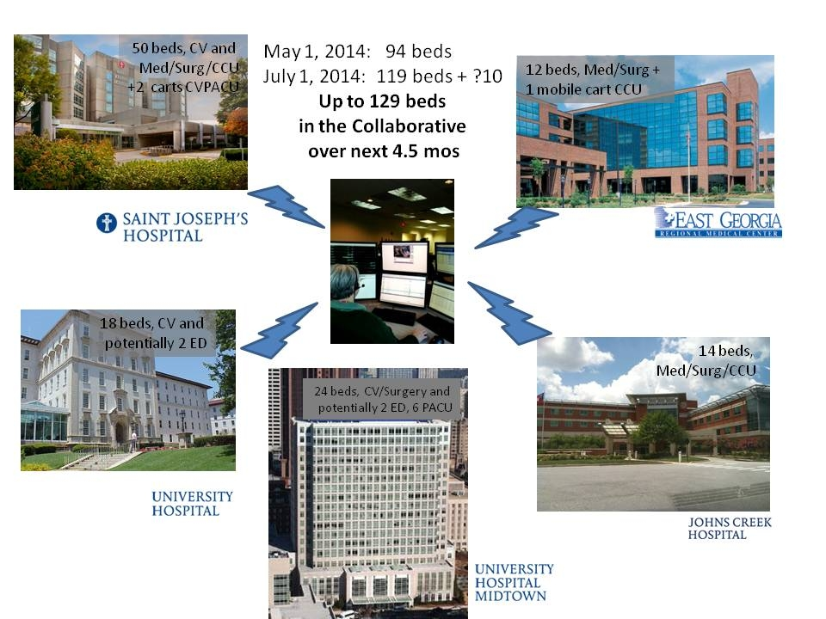
Progressive Managed Growth
May 2014: 94 beds
July 2014: 119 beds
November 2014:133 beds
December 2018 beds: 151 beds
January 2018: 158 beds
January 2020: 168 beds

Slide 4
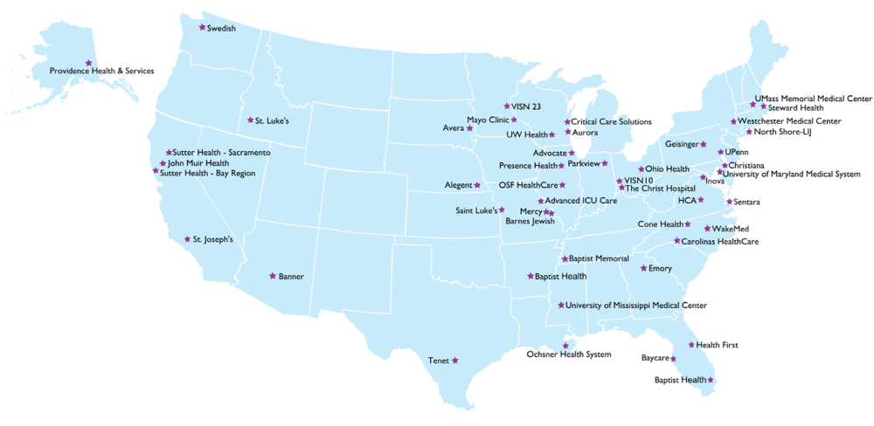


SOUTHEAST: eICU Hubs & Emory services
Emory is the ONLY eICU Provider in Georgia
There are NO eICU providers in SC, AL or North FL
Emory eICU Center
Emory Monitored Hospitals
Request for Services
Emory Monitored Hospit
GEORGIA WANTS MORE eICU SERVICES IN ALL REGIONS

Slide 5

Tools that increase situational awareness

Slide 6
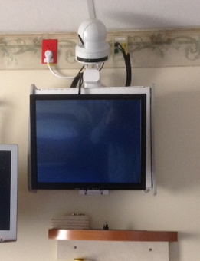

In Room Equipment

Slide 7



Bidirectional Audio Visual Capability

Slide 8
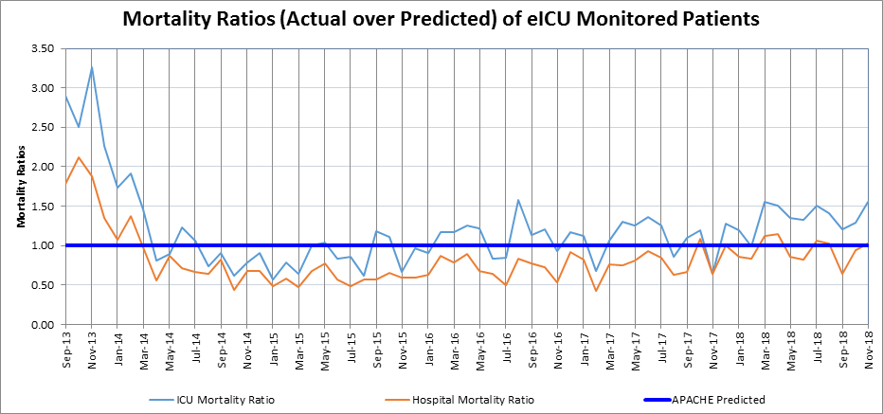
Emory eICU Results:
Community-Centered Hospital
eRNs
eMDs
Notes:
8
Physicians provide guidance and have the greatest impact on efficiency of care. We can deliver 24 x 7 service to hospitals and environments that have traditionally functioned 5 x 12.

Slide 9
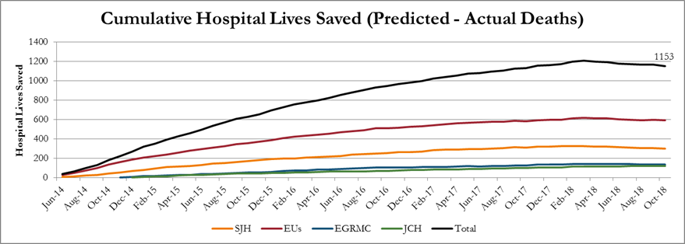
Lives Saved
Notes:
But what matters are lives. Again using the Apache 4 comparison, we estimate around 600 lives saved over 16 months—around one life for every 20 unique patients.

Slide 10
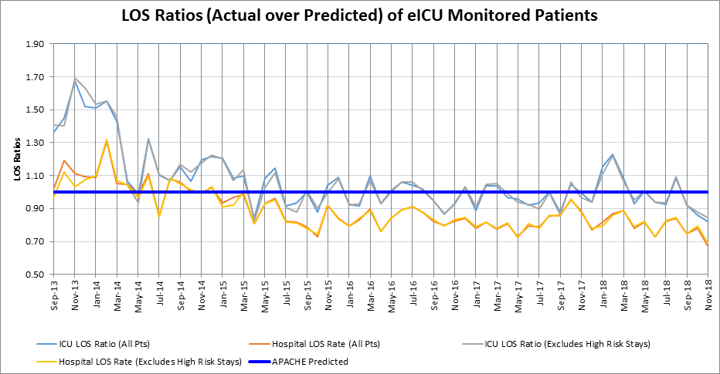
Emory eICU Results:
Community-Centered Hospital
eRNs
eMDs
Notes:
10
Nurses as safety officers have the greatest impact on mortality. Our eRNs at night—the time of highest risk, average more than 20 years f bedside experience.

Slide 11
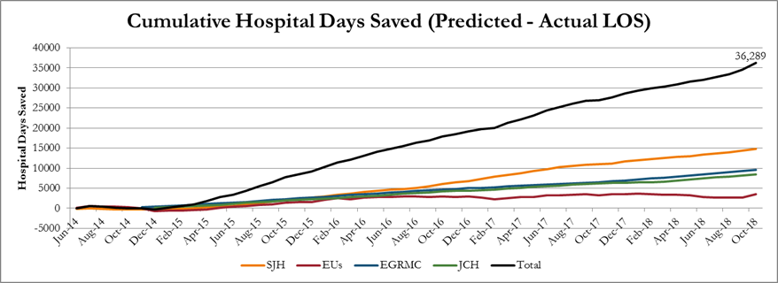
Resources Conserved
This savings is equivalent to building and staffing a fully occupied 20 bed ICU
Notes:
But what matters are lives. Again using the Apache 4 comparison, we estimate around 600 lives saved over 16 months—around one life for every 20 unique patients.

Slide 12
VTE Best Practice Compliance

Slide 13
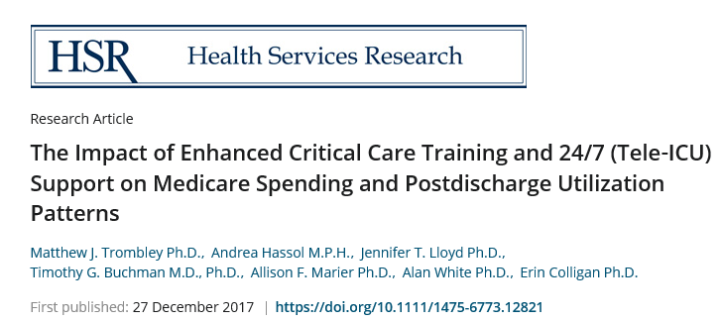
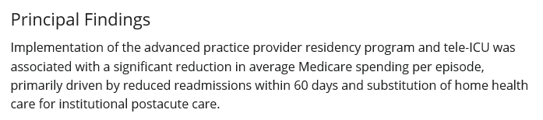
Emory eICU Analysis by Abt

Slide 14
HCIA to Emory Healthcare Grant:
A shared investment approach
$1486
reduction average Medicare Spend per episode of care
Created to further quality to Georgians
60-day inpatient readmits: reduced 2.14%
Discharges to SNF and LTCHS: reduced 6.9%
Discharges to home: increased 4.9%
Inpatient LOS shortened
P<0.01, compared to
contemporary episodes in nine Georgia hospitals providing similar services

Slide 15
East Georgia Regional Medical Center:
Sustainable improvement in rural hospital performance
 | Pre-eICU August 2014 | Post-eICU February 2015 | Current eICU November 2018
ICU Mortality | 8.25 | 3.79% (54%) | 3.6% (56%)
Critical Care Average Daily Census | 7 | 11.8 (41%) | 10.0 (30%)
Transfers from ICU to outside hospital | 8.77 | 6.15 (30%) | 4.6 (48%)
Medicare Case Mix Index | 1.32 | 1.5449 (14%) | 1.6131 (22%)
ICU Length of Stay | 5.1 | 4.7 (18%) | 3.56 (30%)

Slide 16
State of Georgia eICU Grant:
A Shared Investment Approach
FY 19 Georgia State budget line item: $600,000 to catalyze rural adoption of eICU
  Administered through the Office of Rural Health
  Emory as the only hub in Georgia to be service provider
Application process is finalized and open to qualifying Rural hospitals interested in implementing eICU services
  Two awards planned
  Each awardee will have one year to spend money to implement eICU services
A demonstration project, not a long term solution, so long term sustainability must be planned by the awardees

Slide 17
Pro forma for a 15 bed ICU (approximate costs) | Standard Cost Model | Discount | eICU solution State Grant Cost Model
Initial Capital Outlay | $419,914 | $16,589 Attributed to Yorktel (AV service provider) discount | $419,914
Annual Operating Costs in Year 1 | $645,000 | $495,000 Attributed to Emory service discounts, with graduated increase over three years to fair market value | $198,716
 | $1,064,914 | $511,589 | $618,630 -$300,000 Grant $318,630 first year cost to awardee
71%
less

